Slide 1



ASSETS 2022 Title Slide
The 24th International ACM SIGACCESS Conference on Computers and Accessibility
Athens, Greece
Oct 23-26
Notes:
Good morning!
Kaliméra – Cali-mera

Slide 2
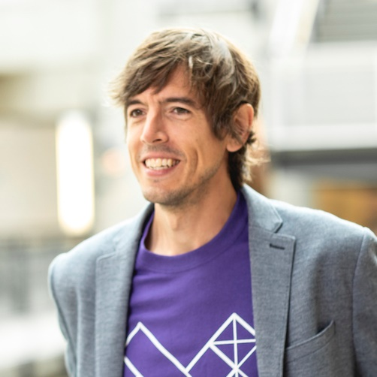
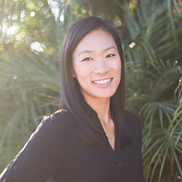
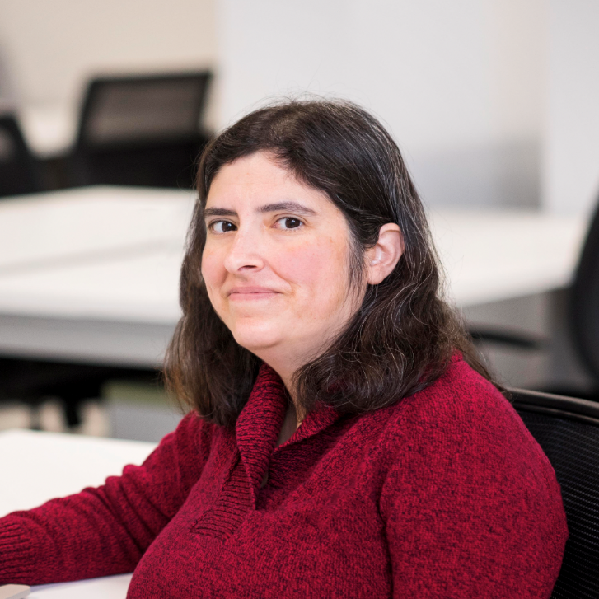
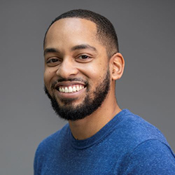
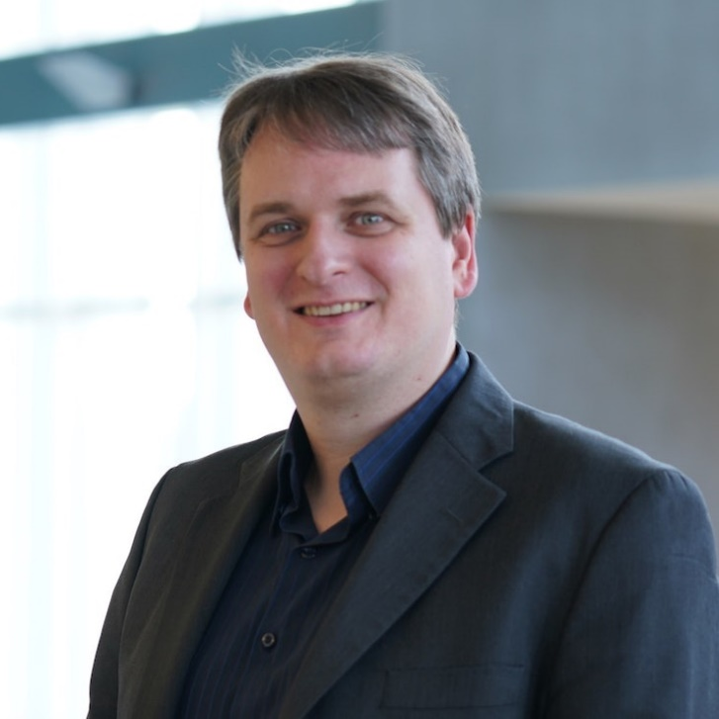
ASSETS’22 Leadership Team
Opening plenary
General Chair
Technical Program Chairs
Treasurer / Registration Chair
Hybrid Experience Chair
Jon E. Froehlich
University of Washington
Kristen Shinohara
Rochester Institute of Technology
Stephanie Ludi
University of North Texas
Martez Mott
Microsoft Research
Christian Vogler
Gallaudet University
Notes:
I’m Jon Froehlich, an Associate Professor in Computer Science at UW and the General Chair of ASSETS2022
On behalf of our ASSETS leadership team and the entire Organizing Committee, it is my tremendous pleasure to welcome you to ASSETS in Greece

Slide 3
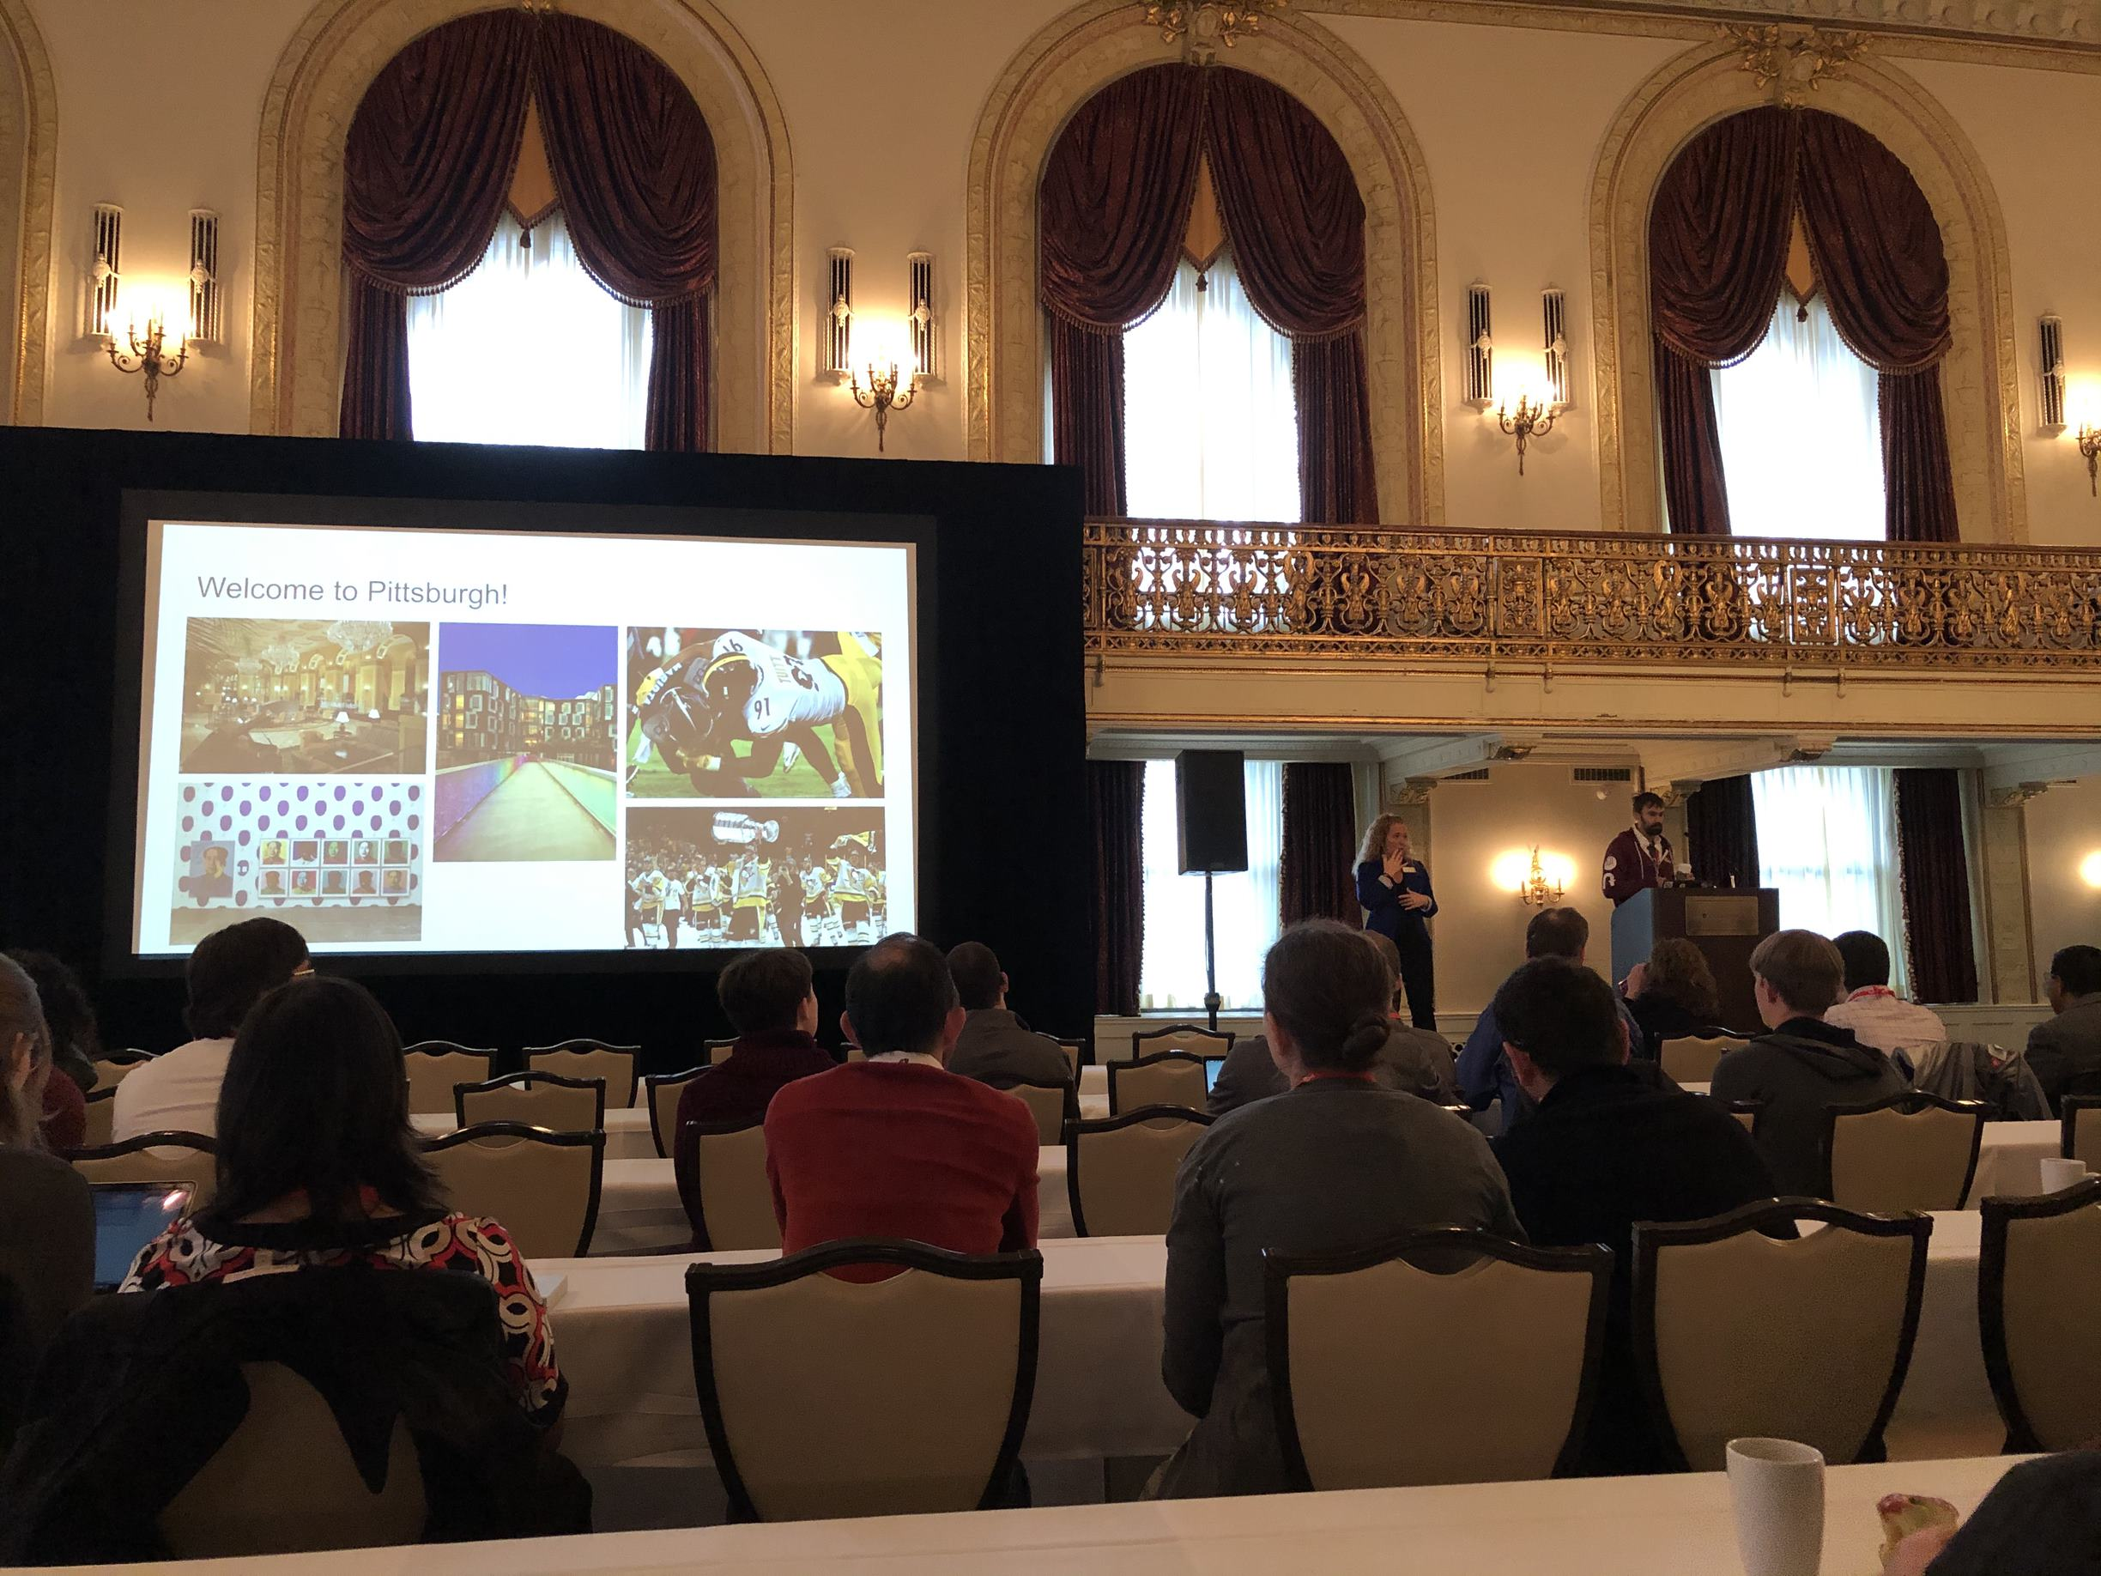
Back to 2019
Pittsburgh, PA
Notes:
I want to take you back to ASSETS’2019. I’m showing a picture of General Chair Jeff Bigham at the opening ceremony in the beautiful Omni William Penn hotel conference room

Slide 4
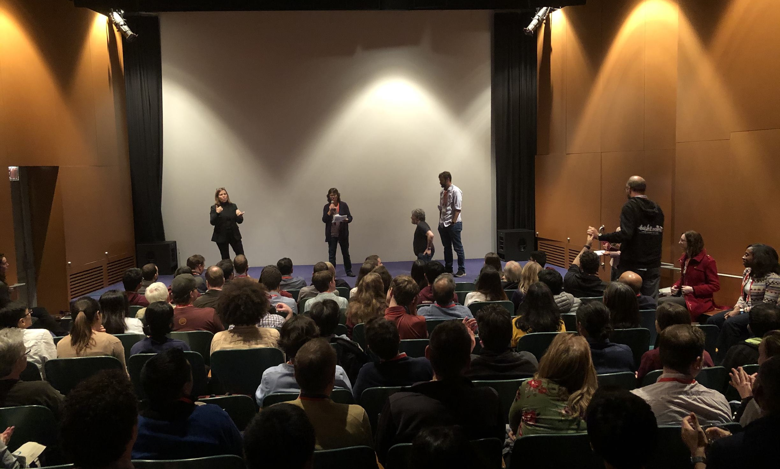
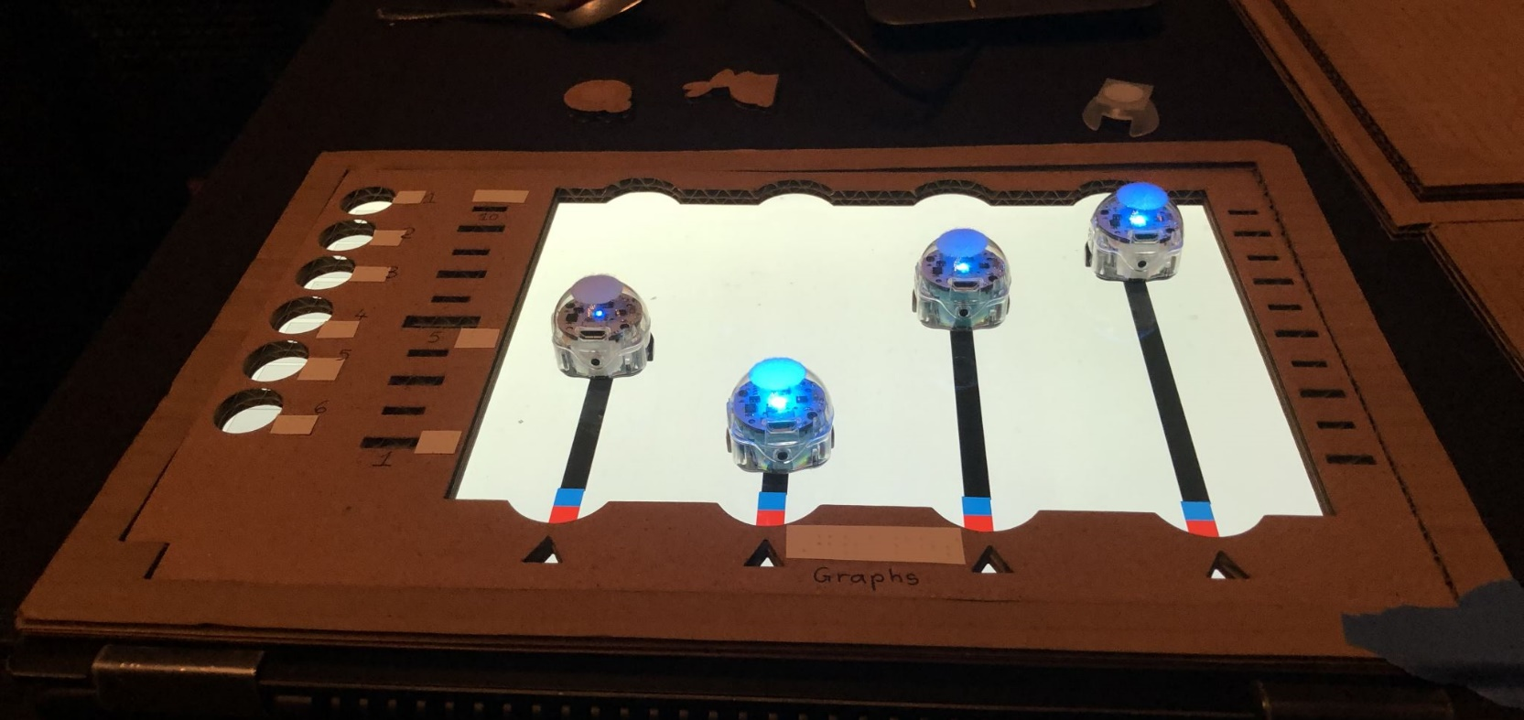
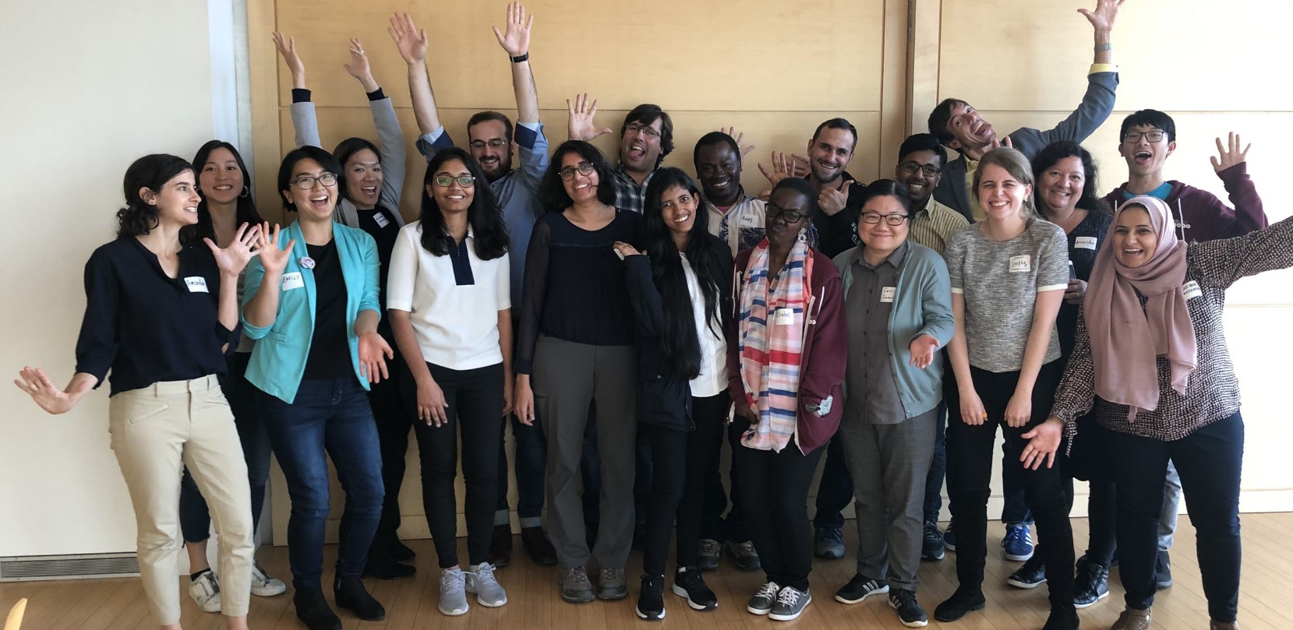
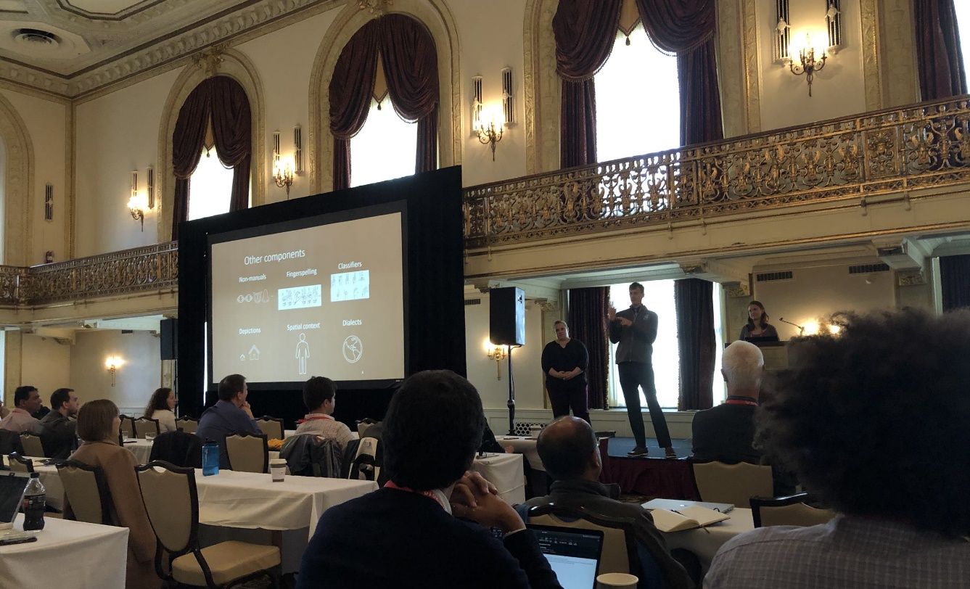
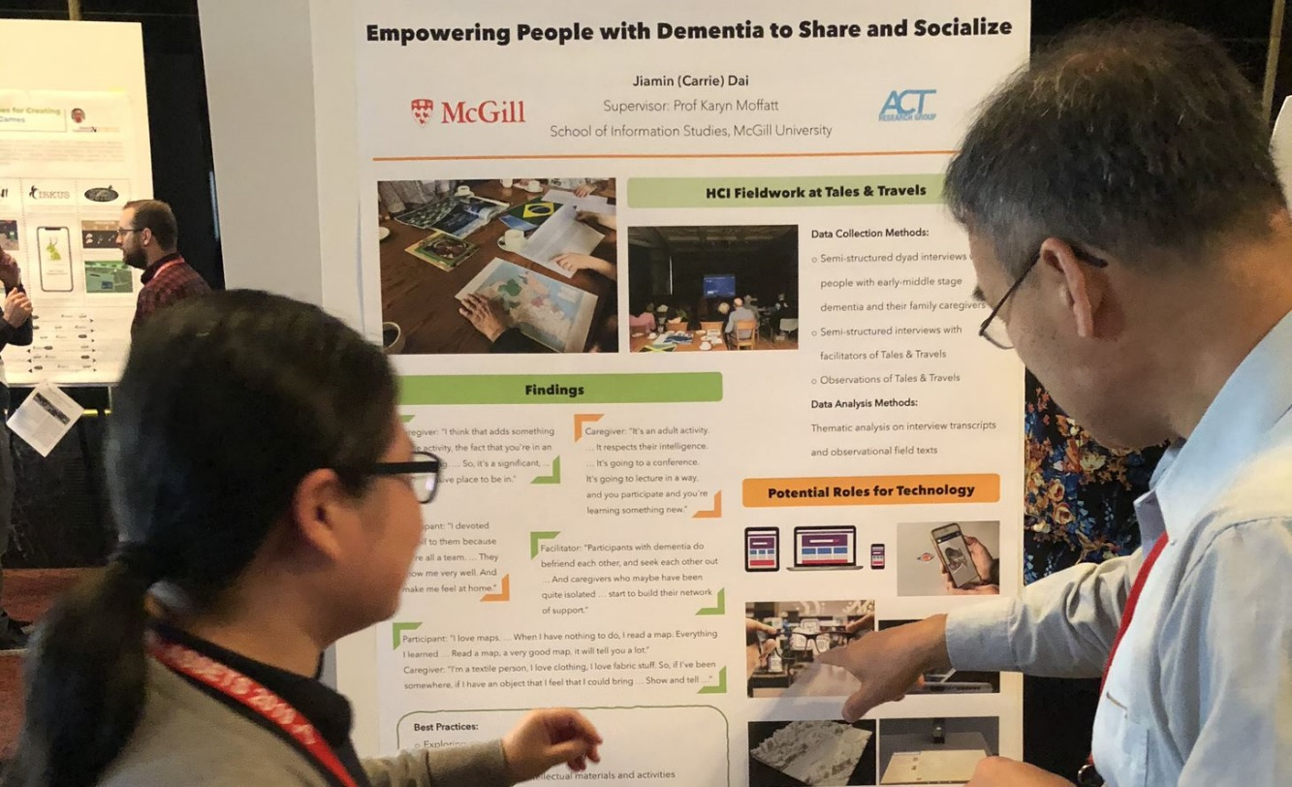
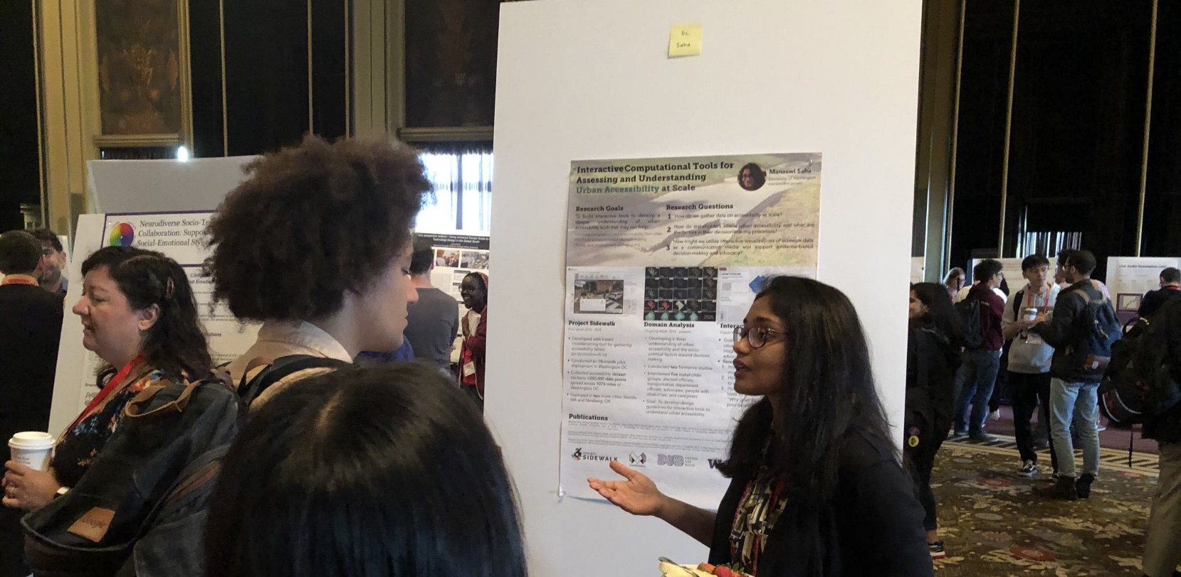
ASSETS 2019
Pittsburgh, PA
Notes:
This is the last time we were all physically together: talking, showing demos, interacting with posters, and each other.
I’m showing pictures of the ASSETS’19 award ceremony with Kathleen McCoy, Shaun Kane, and Jeff Bigham on stage and images from the ASSETS’19 doctoral consortium, poster sessions, and a talk session.

Slide 5
We are now back together again
Notes:
We have a similarly exciting program for Day 2

Slide 6
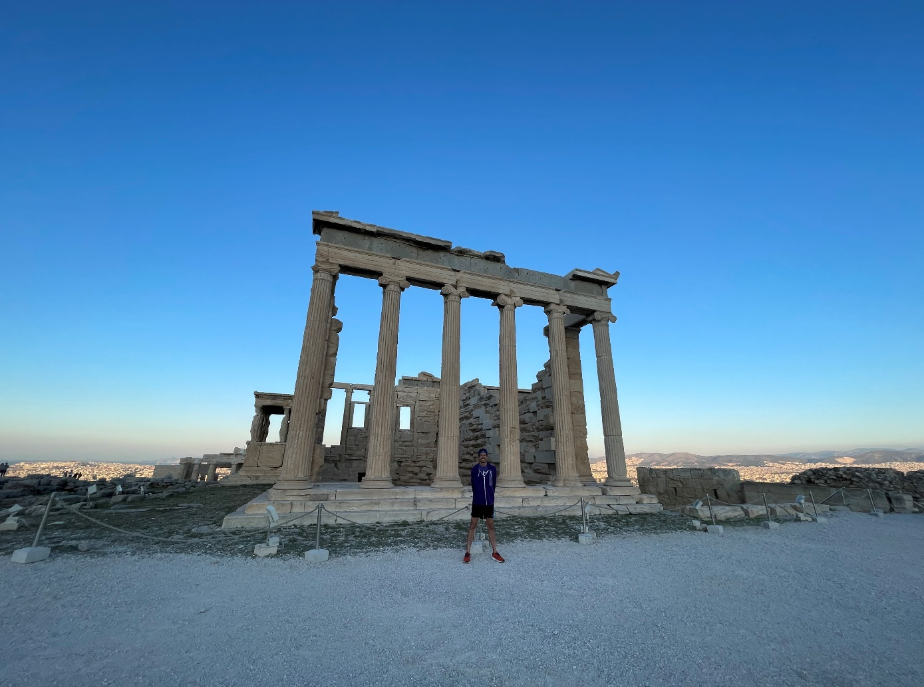
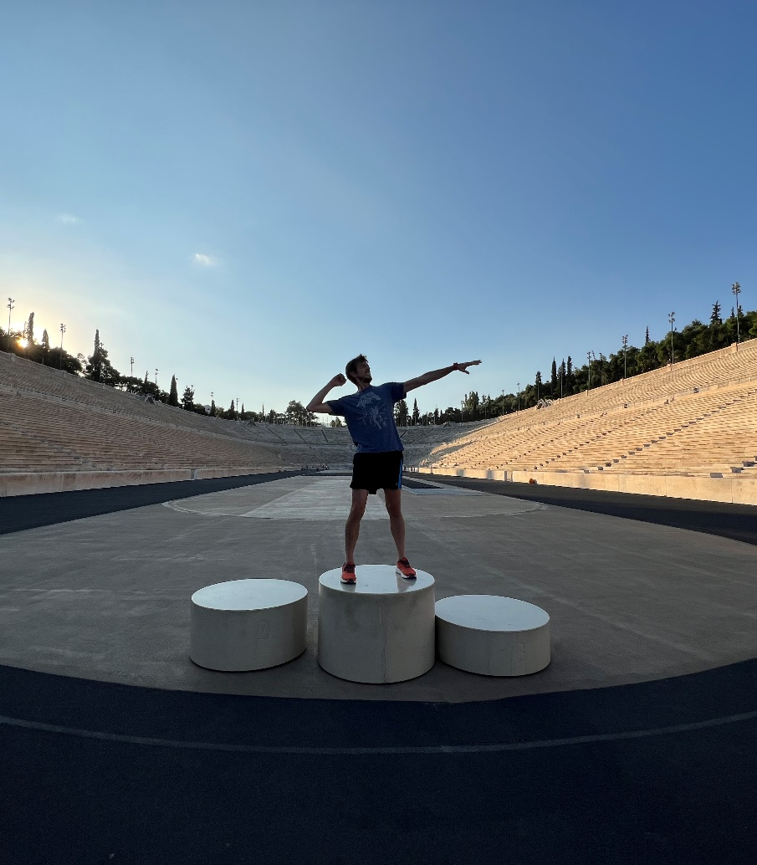
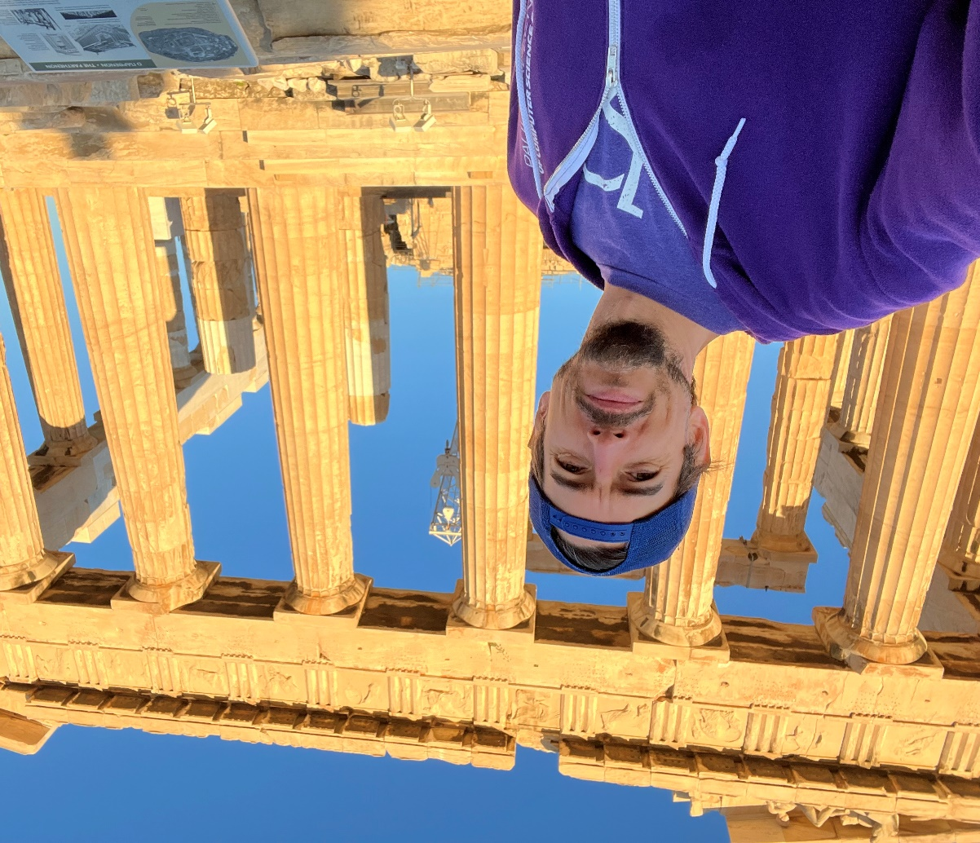
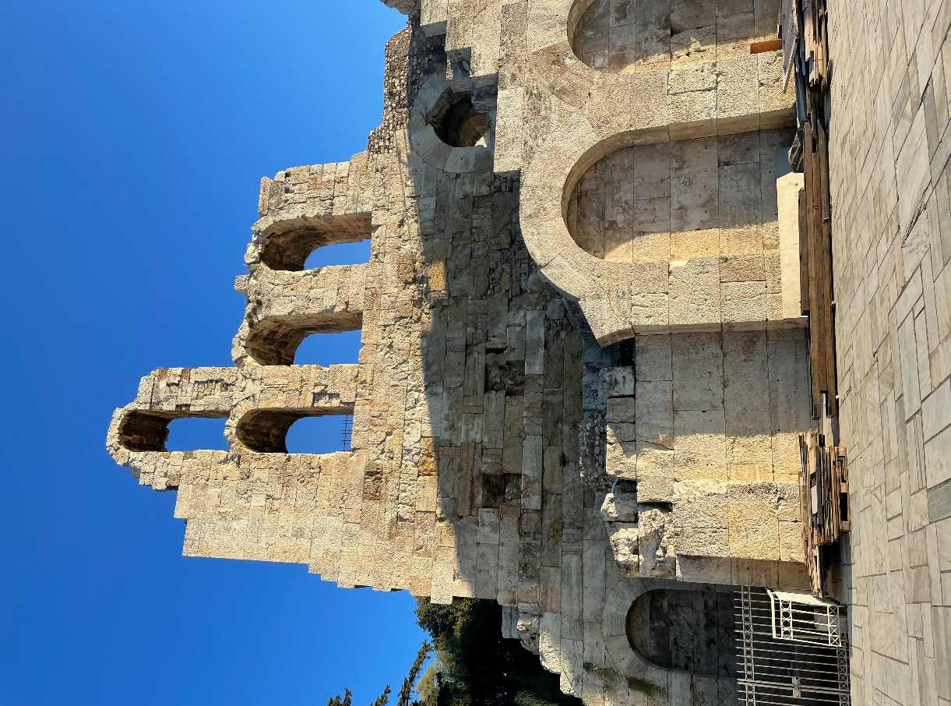
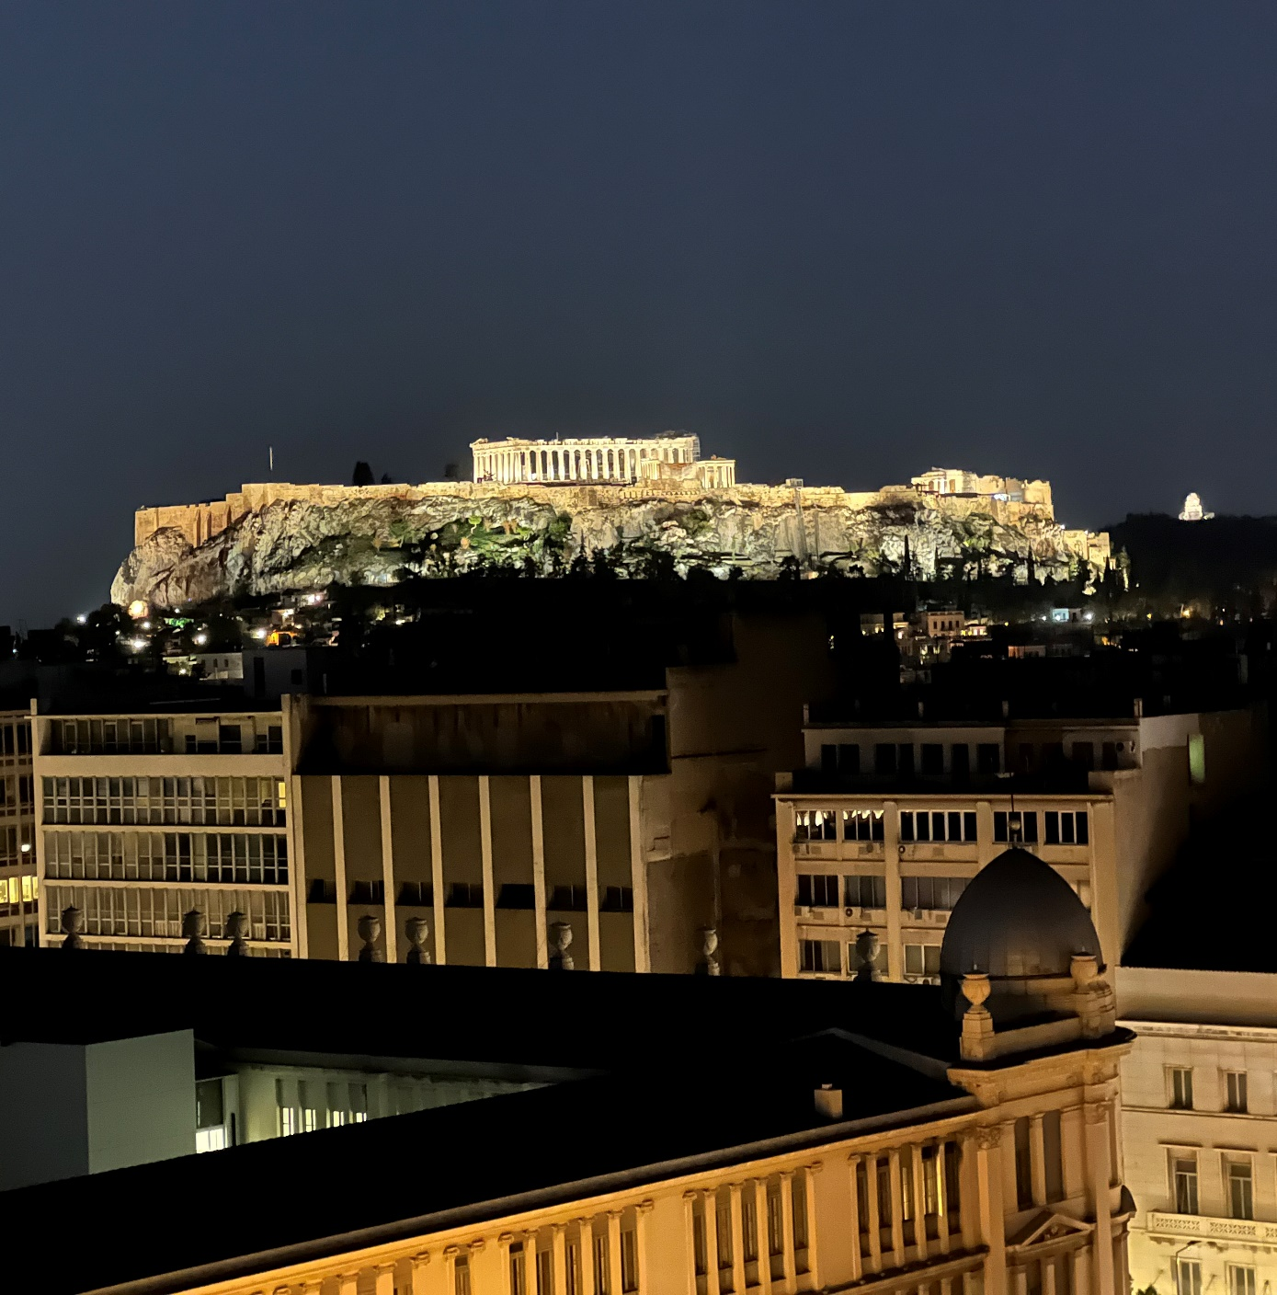
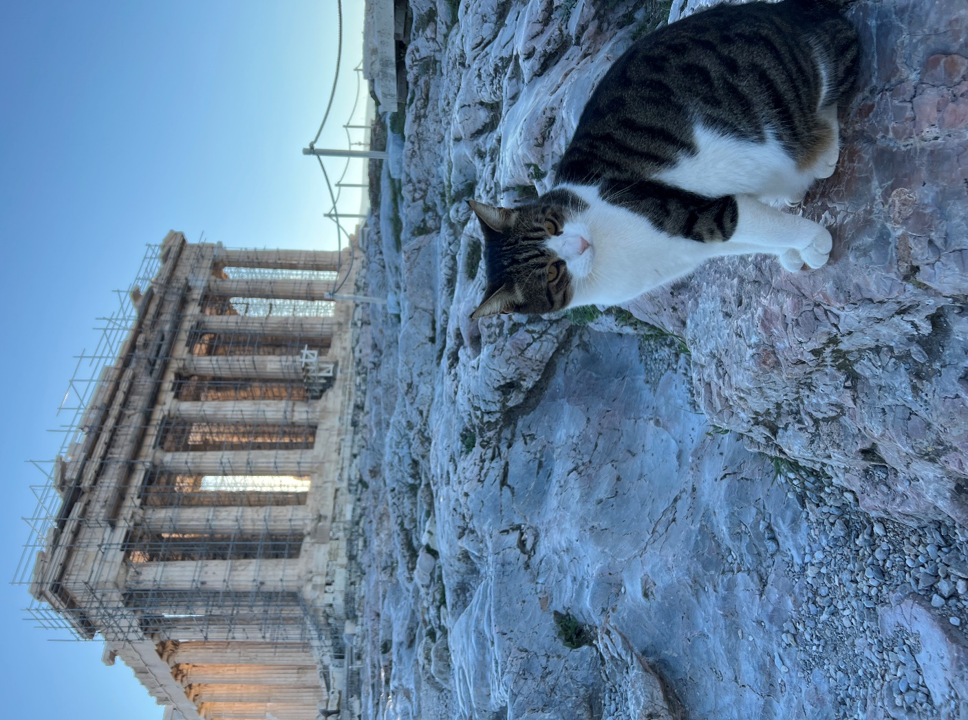
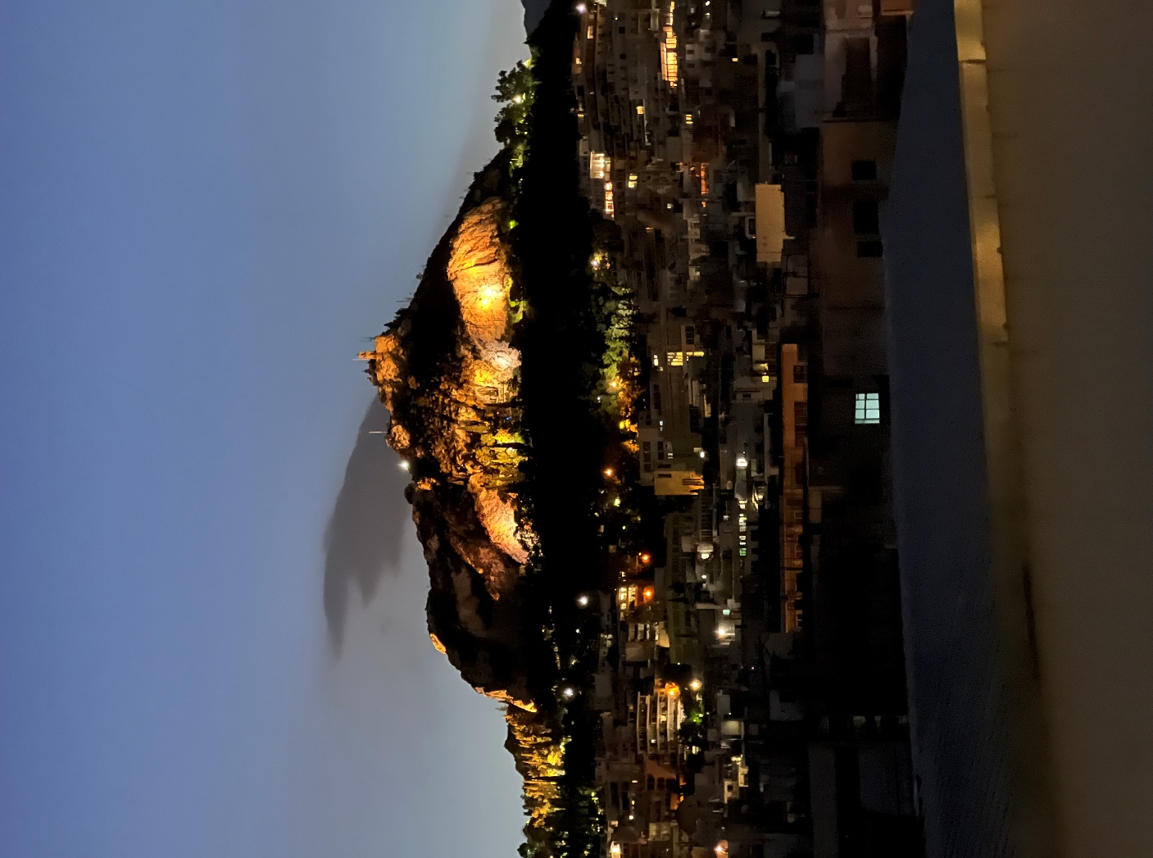
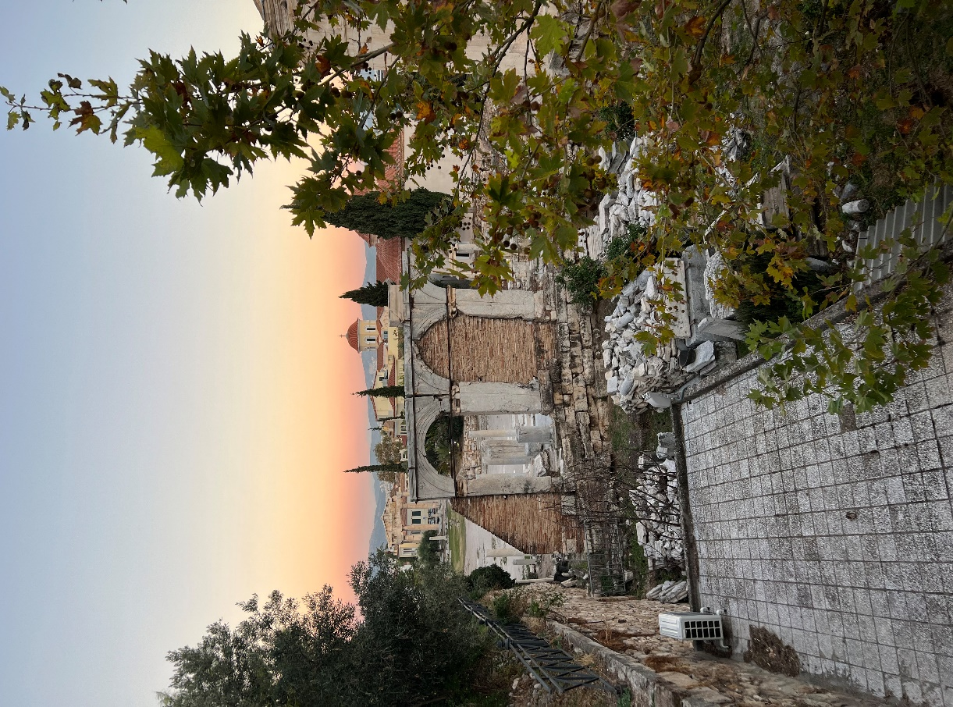
Exploring
Athens, Greece
Notes:
Exploring this historic city of Athens Greece: the birth of democracy, the site of so many beautiful antiquities

Slide 7
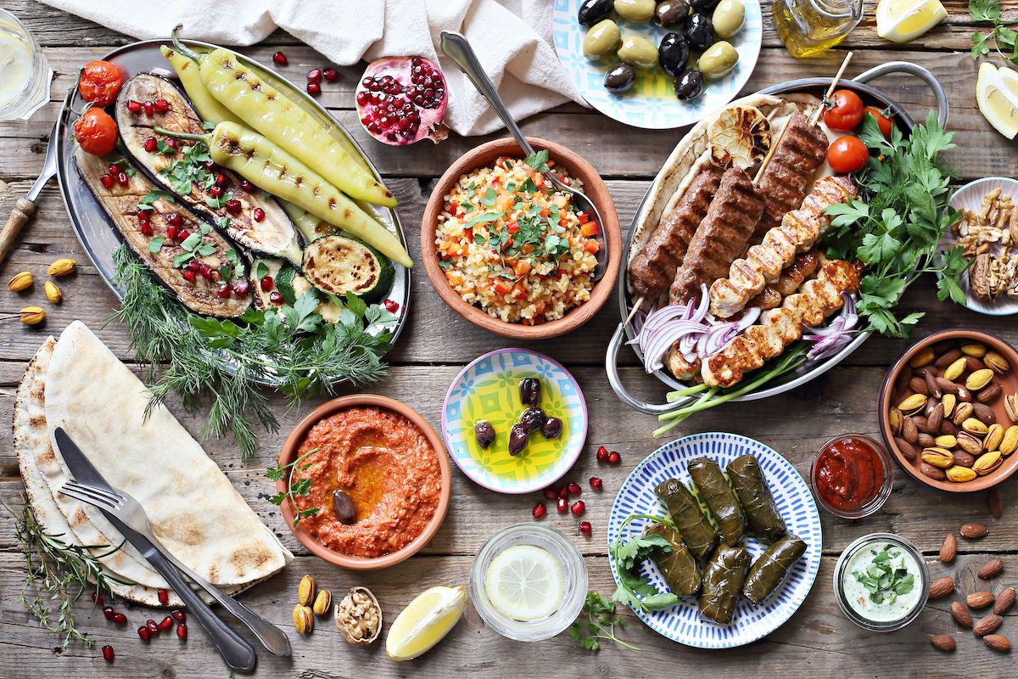
Eating food!
Athens, Greece
Notes:
Eating gyros, souvlaki, olives, dolmas, and fresh tomato

Slide 8
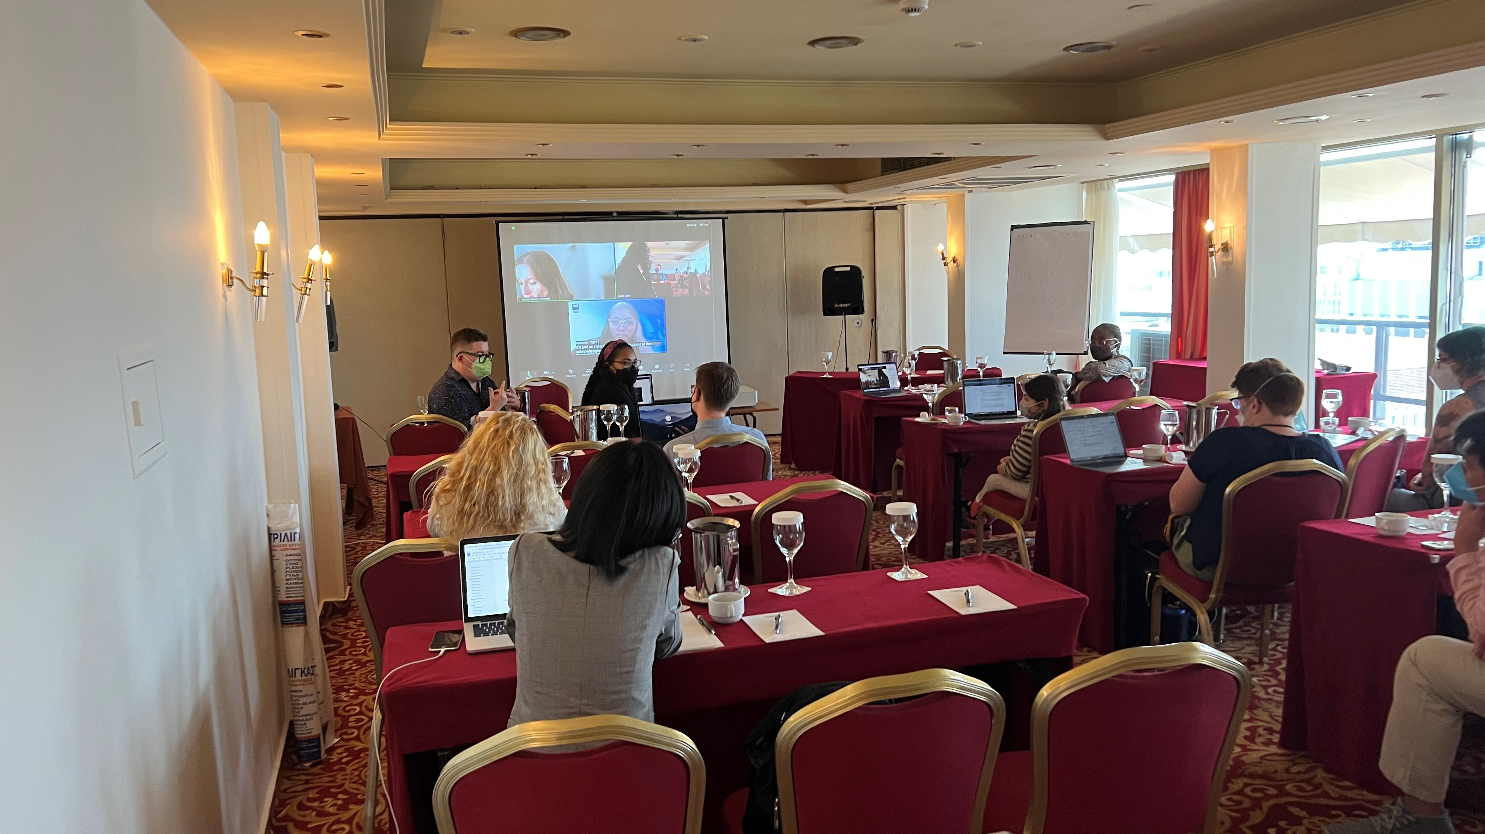
Exchanging Ideas
Exchanging ideas
Doctoral Consortium
Katta Spiel
Aqueasha Martin-Hammond
Notes:
And perhaps most importantly exchanging ideas. Yesterday, our conference kicked off officially in Athens with the first-ever hybrid Doctoral Consortium led by Katta Spiel and Aquesha (Aqway-sha) Martin-Hammond
--
who had both in-person and virtual talks all while overlooking the Acropolis and Parthenon

Slide 9
Conferences Are About People
Notes:
Conferences are about people. Talking, learning, growing together

Slide 10
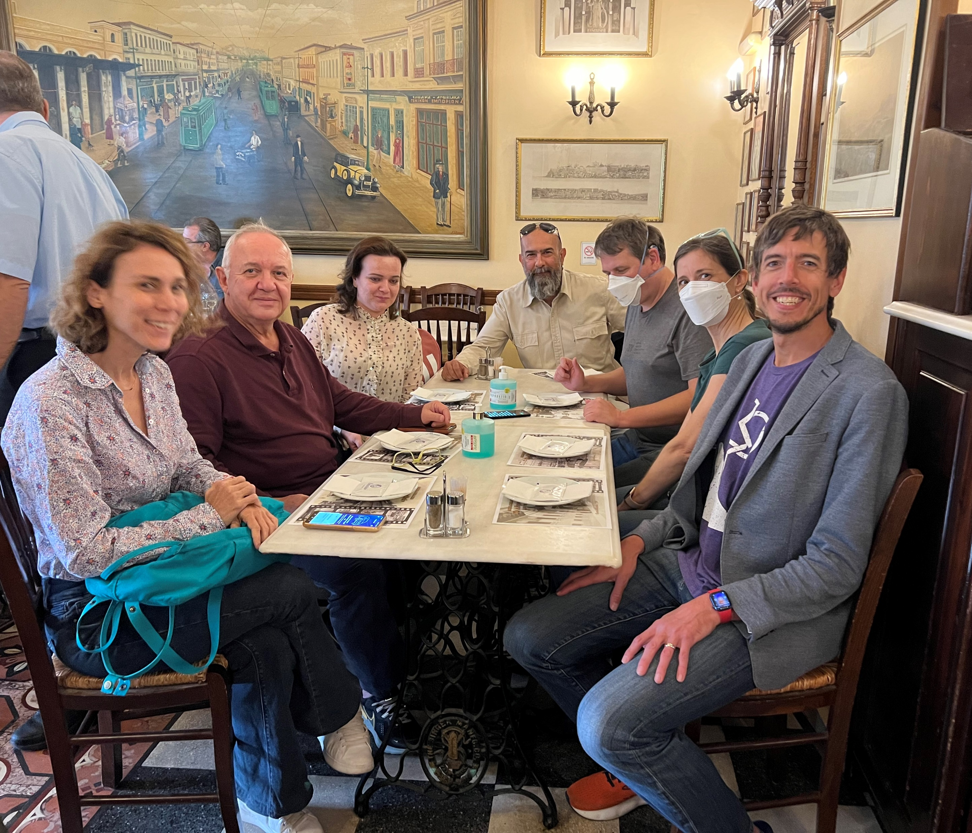
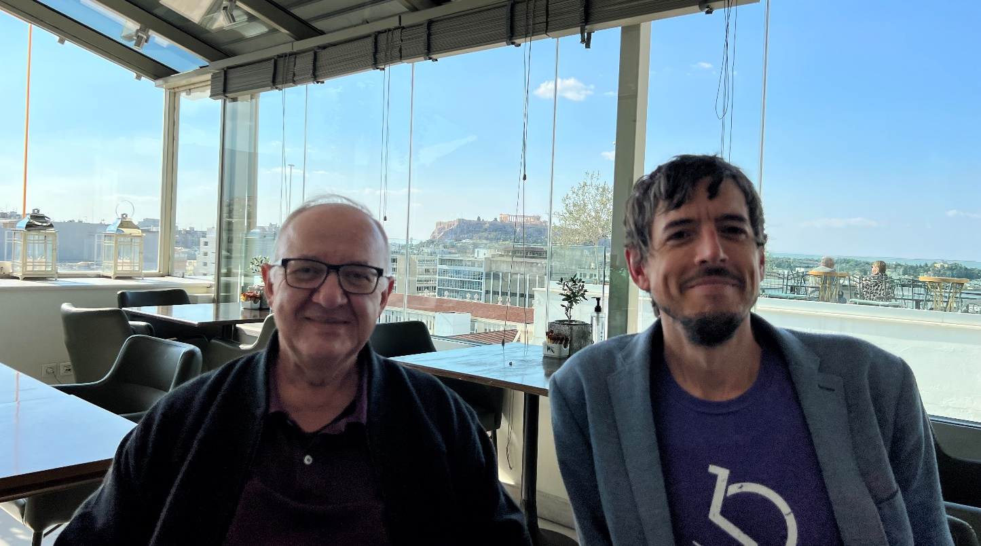
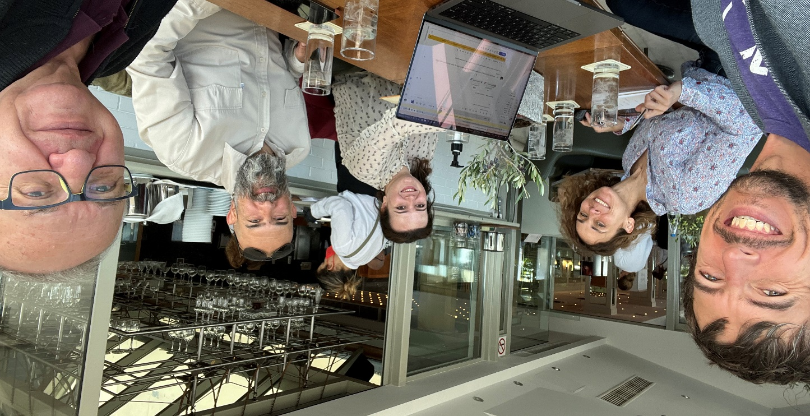
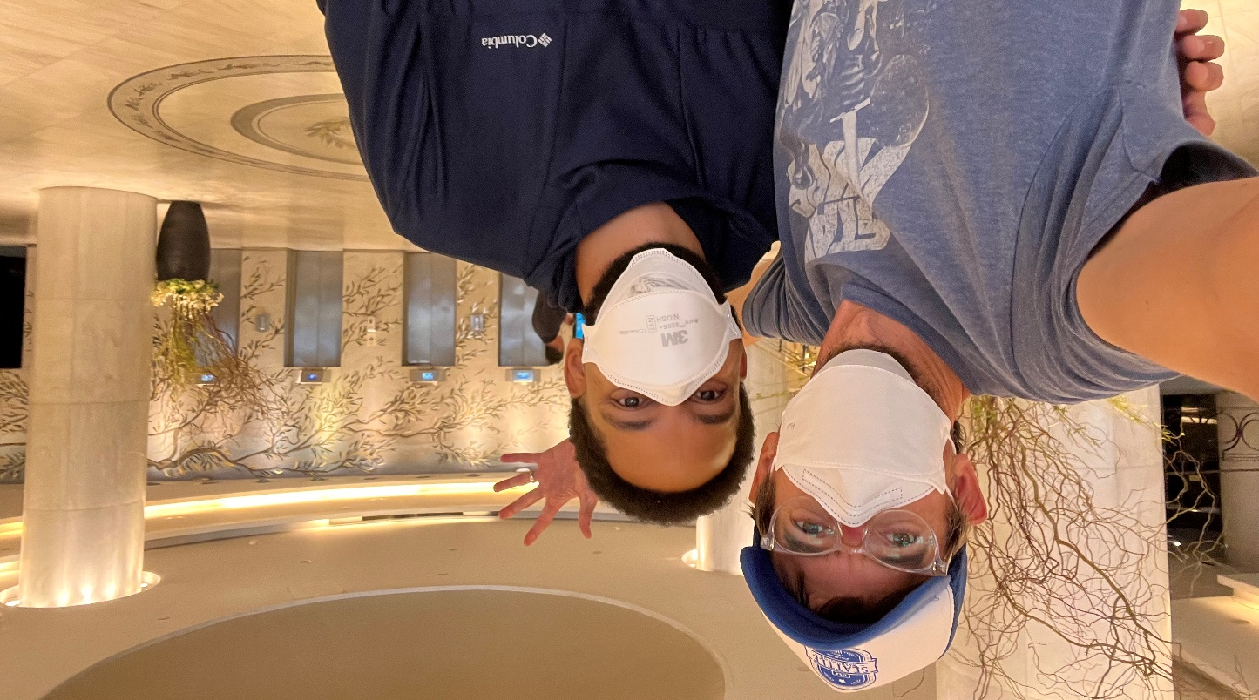
People
ASSETS’22
Notes:
I have greatly enjoyed meeting new people and reconnecting with old friends these last few days as we finish final preparations. I’m showing pictures of meetings with the local chairs and ASSETS leadership team in Athens
--
I can’t wait for you all to meet one another, make new friends, discuss projects, and begin new collaborations.

Slide 11
302 Participants
302
Participants
Notes:
And, I’m proud to announce ASSETS2022 has 302 participants

Slide 12


Split of In-Person and Virtual
161
141
In-person
Virtual
Notes:
161 in person and 141 virtual

Slide 13
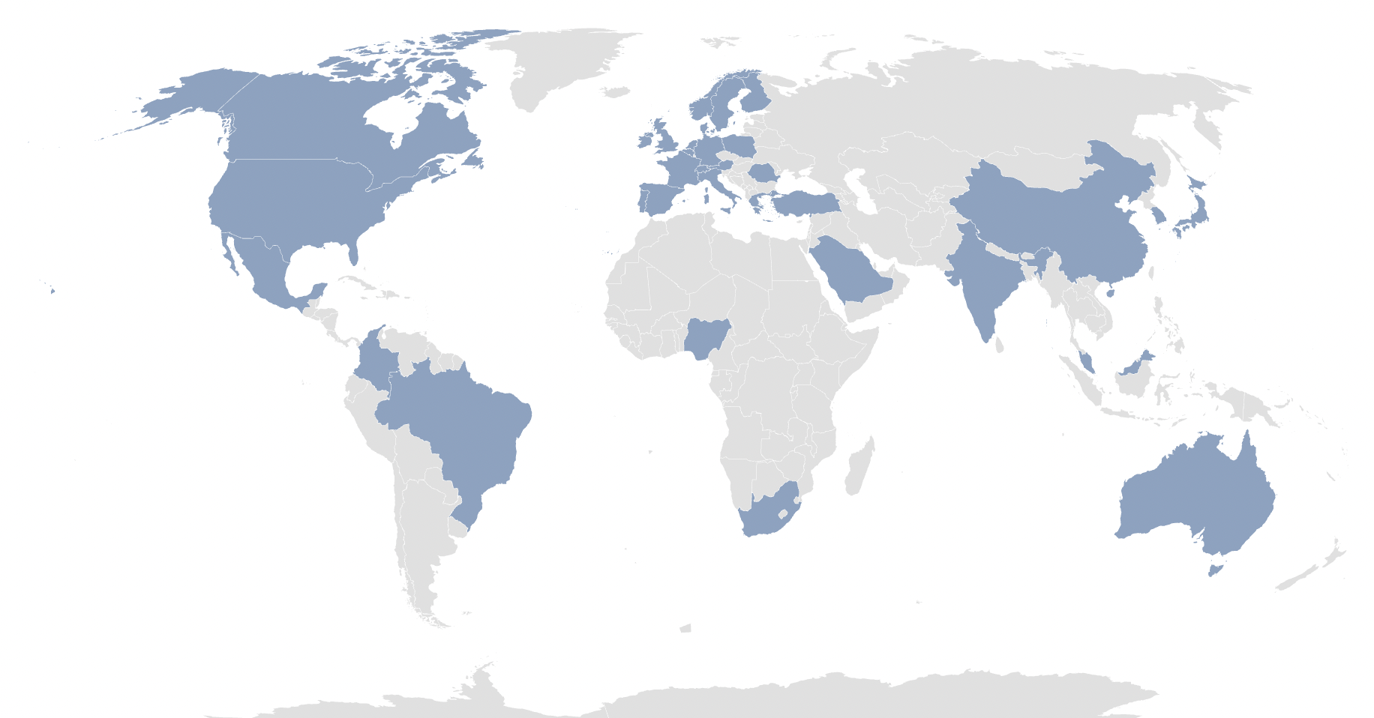
Country Registrations
37
Countries
Notes:
from 37 countries including all continents except for Antarctica

Slide 14
151 Workshop Participants
151
Workshop Participants
Notes:
And 151 workshop participants in our first-ever ASSETS workshop track

Slide 15
A Greek Welcome
Notes:
To help welcome you to Greece and to ASSETS…

Slide 16
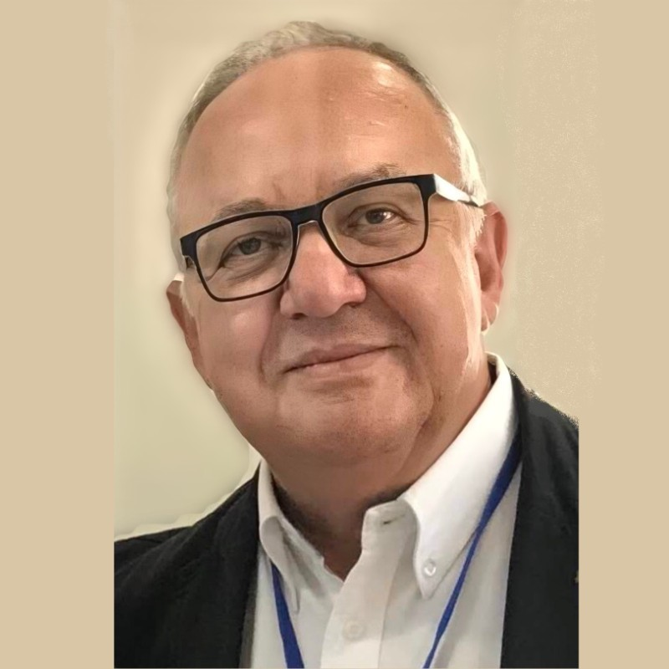
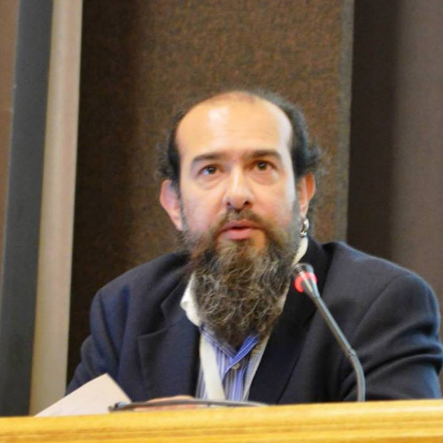
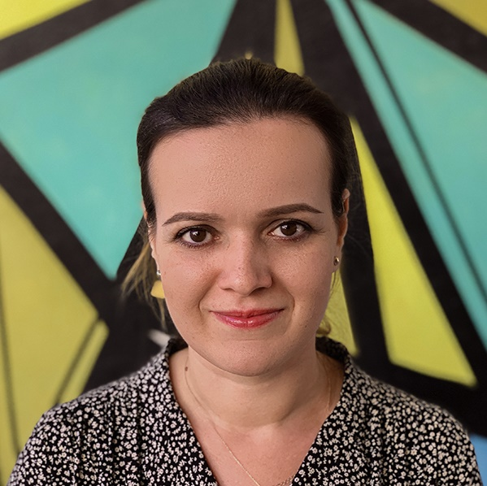
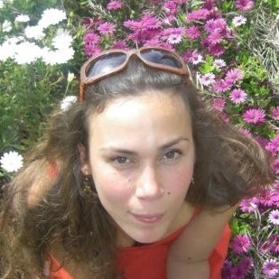
Local Arrangements
ASSETS’22
Local Chairs
Local Accessibility Chairs
Georgios Kouroupetroglou Γεώργιος Κουρουπέτρογλου National and Kapodistrian University of Athens
Alexandros Pino
Αλέξανδρος Πίνο National and Kapodistrian University of Athens
Paraskevi Riga
Βιβή Ρήγα
National and Kapodistrian University of Athens
Ariadni Velissaropoulou
Αριάδνη Βελισσαροπούλου
National and Kapodistrian University of Athens
Notes:
I have asked one of our Local Chairs, Professor Yor-ghoes Coo-roo-petro-glou from the University of Athens to join me on the stage.
--
A dedicated set of local arrangements chairs from the National and Kapodistrian University of Athens (NKUA) who have extensive knowledge of Athens and accessibility: Georgios, Alexandros, Paraskevi, Ariadni

Slide 17
Local Arrangements
ASSETS’22
President, Association for the Advancement of Assistive Technology in Europe (AAATE)
Director, Speech and Accessibility Laboratory, University of Athens (http://speech.di.uoa.gr)
Head, Accessibility Unit for Students with Disabilities, University of Athens (http://access.uoa.gr)
Georgios Kouroupetroglou Γεώργιος Κουρουπέτρογλου National and Kapodistrian University of Athens
Notes:
Yor-ghoes is a leader in accessibility in Greece and the President of the Association for the Advancement of Assistive Technology in Europe

Slide 18
Georgios Kouroupetroglou
Καλώς ήρθατε !
Georgios Kouroupetroglou Γεώργιος Κουρουπέτρογλου National and Kapodistrian University of Athens
Notes:
Yor-ghoes

Slide 19
Exciting Program
Notes:
Thank you Yorghoes--
We have an incredibly exciting program

Slide 20
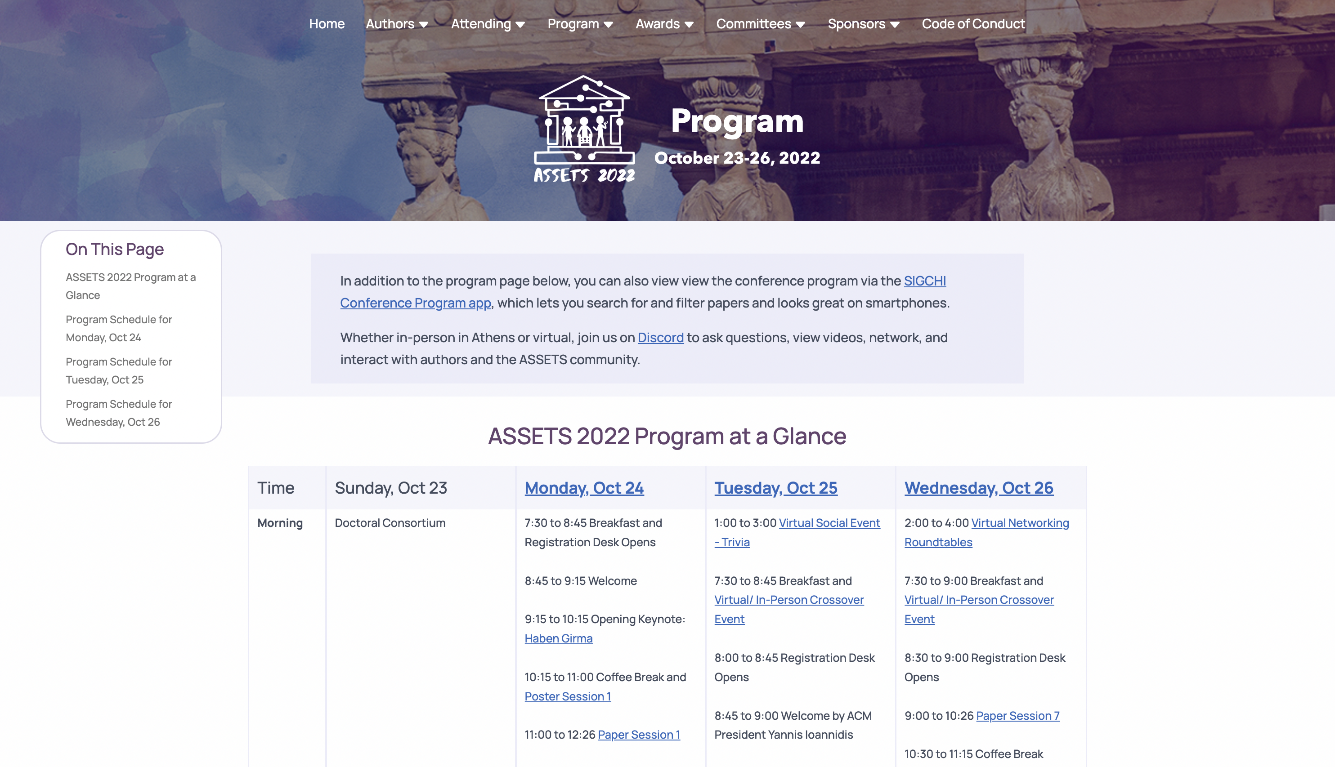
Website Program
https://assets22.sigaccess.org/program.html
Notes:
I encourage you to spend some time on the ASSETS’22 program website to get an overview of our schedule

Slide 21
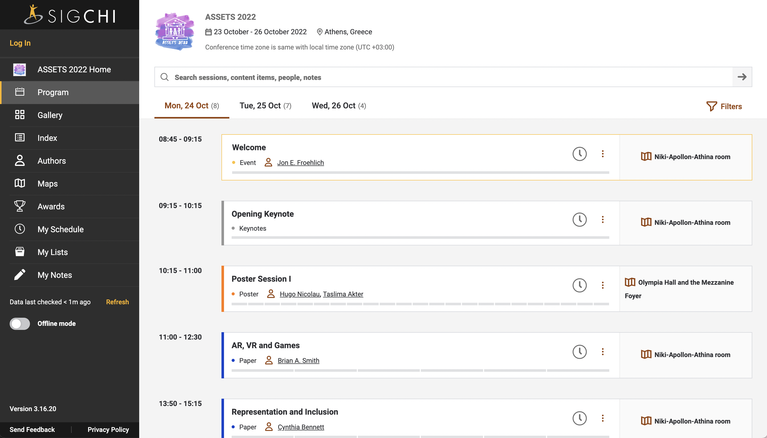
Website Program
https://programs.sigchi.org/assets/2022
Notes:
We also, for the first time in our conference history, have our program listed in the SIGCHI conference app, which works great on the web or mobile and is screen reader accessible

Slide 22
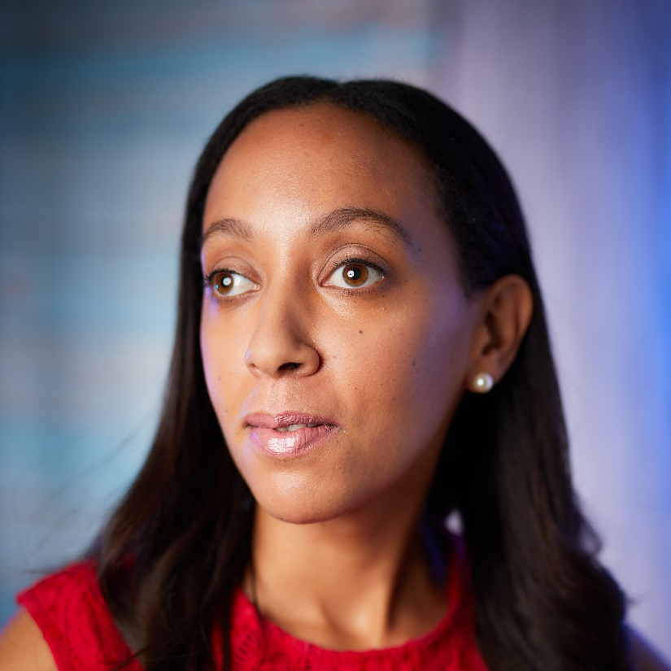
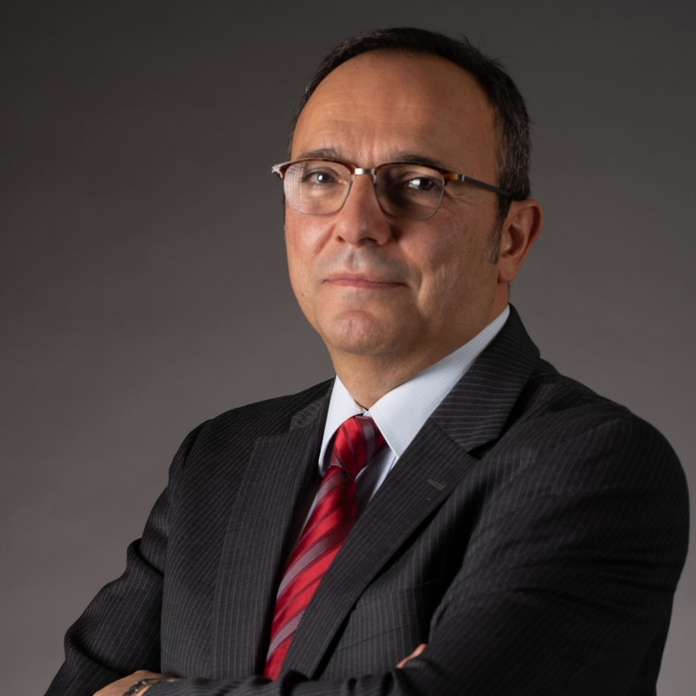
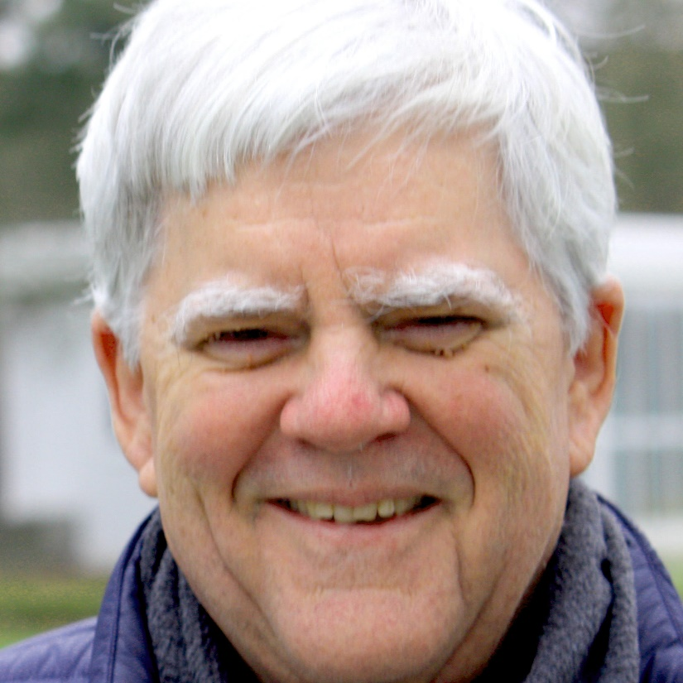
Distinguished Guests
Schedule
Monday
Tuesday
Georgios Kouroupetroglou President, Advancement of Assistive Technology in Europe; Prof, NKUA
Haben Girma
Human rights lawyer advancing disability justice
Yannis Ioannidis President, ACM Professor, NKUA
Clayton Lewis Professor Emeritus, U. of Colorado SIGACCESS Outstanding Contribution
Notes:
We are honored to have a number of distinguished guests,
We just heard from Yor-ghoes and we will soon have our Opening Keynote: Haben Girma
Tuesday, we have ACM President Yannis EE-O-A-Nee-Dis and SIGACCESS Outstanding Contribution Awardee Clayton Lewis

Slide 23
Evening reception
Mon, Oct 24 19:00-21:00
+
Food
Demos
Notes:
Tonight from 7-9PM, we have demos and an evening reception just outside this conference hall

Slide 24
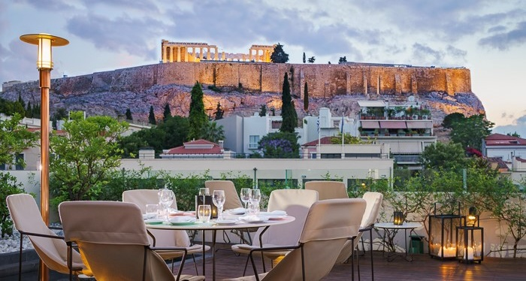
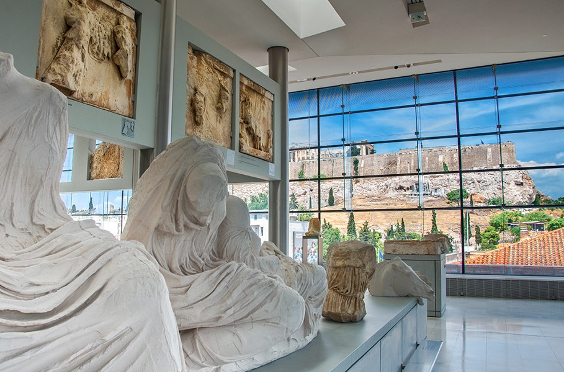
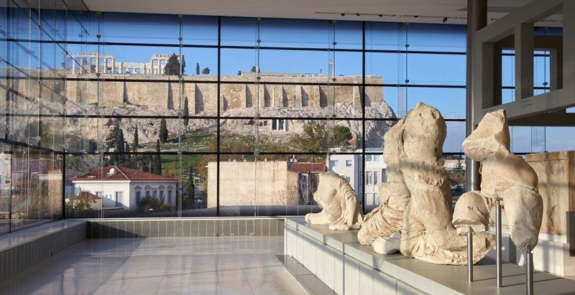
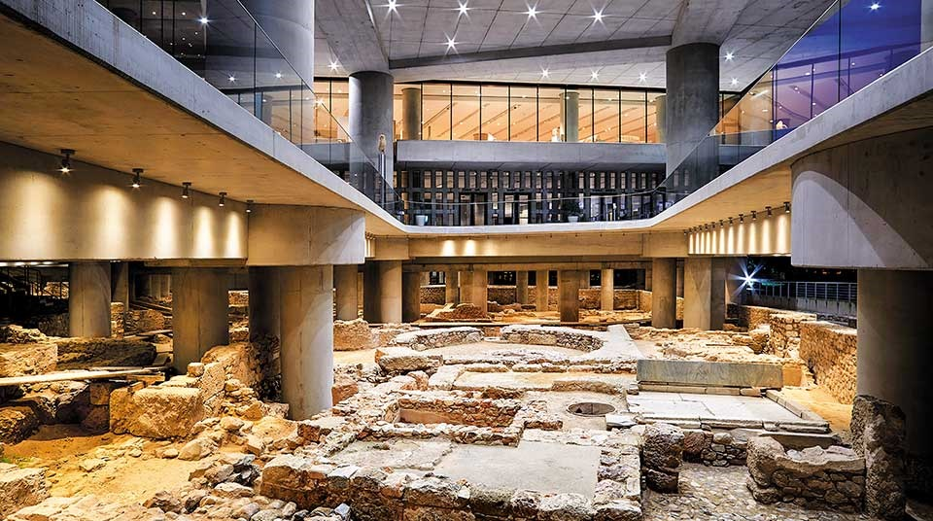
Acropolis Museum
Tues, Oct 25 | 20:00-23:30
Notes:
On Tuesday evening, we will go to the Acropolis Museum where will have private tours and a dinner

Slide 25
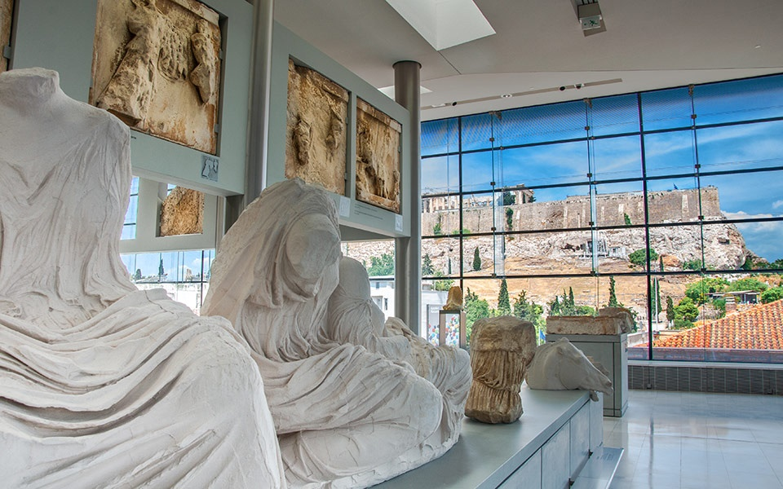
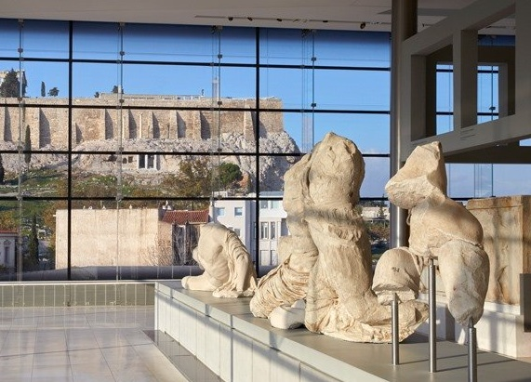
Acropolis Museum
Tues, Oct 25 | 20:00-23:30
The museum is ~2km away from Hotel Titania.
07:50PM Arrive at Acropolis Museum
08:00PM Guided tours begin
09:00PM Eat at Acropolis Café
11:30PM Close
Notes:
Please arrive promptly as the private tours begin at 8PM
After the tours, we will eat at the Acropolis Cafe

Slide 26
Acropolis Museum
Tues, Oct 25 | 20:00-23:30
The museum is ~2km away from Hotel Titania.
07:15PM Group leaves from hotel (optional)
07:50PM Arrive at Acropolis Museum
08:00PM Guided tours begin
09:00PM Eat at Acropolis Café
11:30PM Close
Notes:
If you would like to go to the museum with a group, they will leave at 7:15 from the hotel. See Discord

Slide 27
Technical Program
ASSETS’22
General Chair
Technical Program Chairs
Treasurer / Registration Chair
Hybrid Experience Chair
Jon E. Froehlich
University of Washington
Kristen Shinohara
Rochester Institute of Technology
Stephanie Ludi
University of North Texas
Martez Mott
Microsoft Research
Christian Vogler
Gallaudet University
Notes:
To talk more about our Technical Program, I’d like to invite Technical Program Chair Kristen Shinohara to the podium

Slide 28
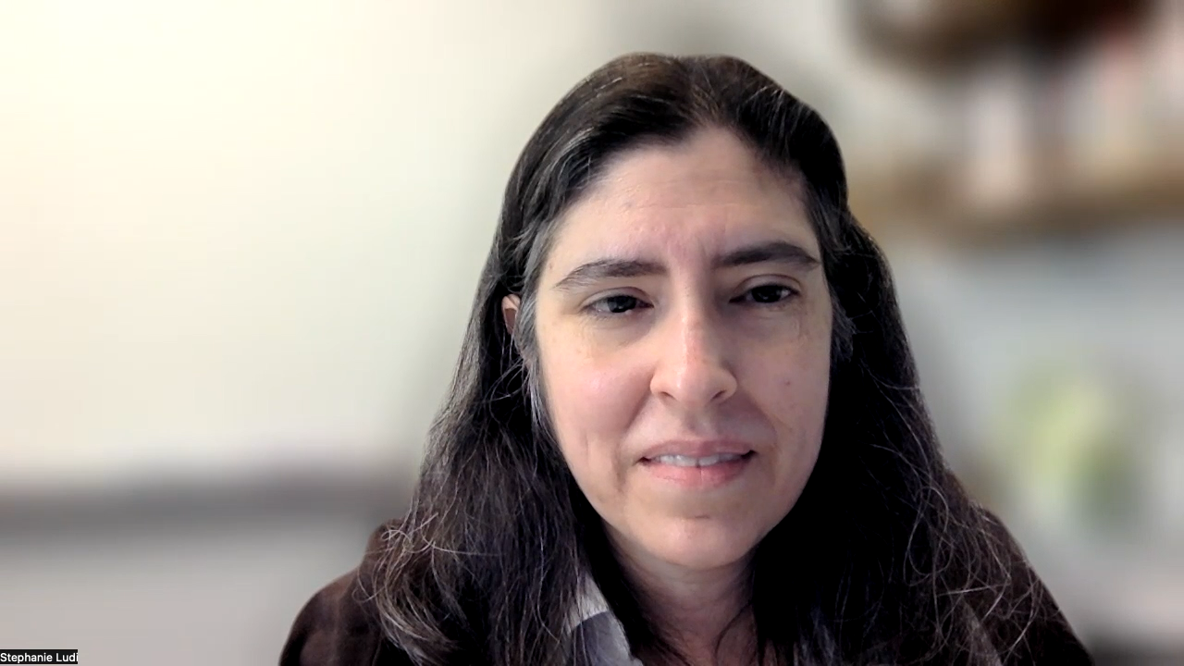
TPC Chair: Stephanie Ludi

Slide 29
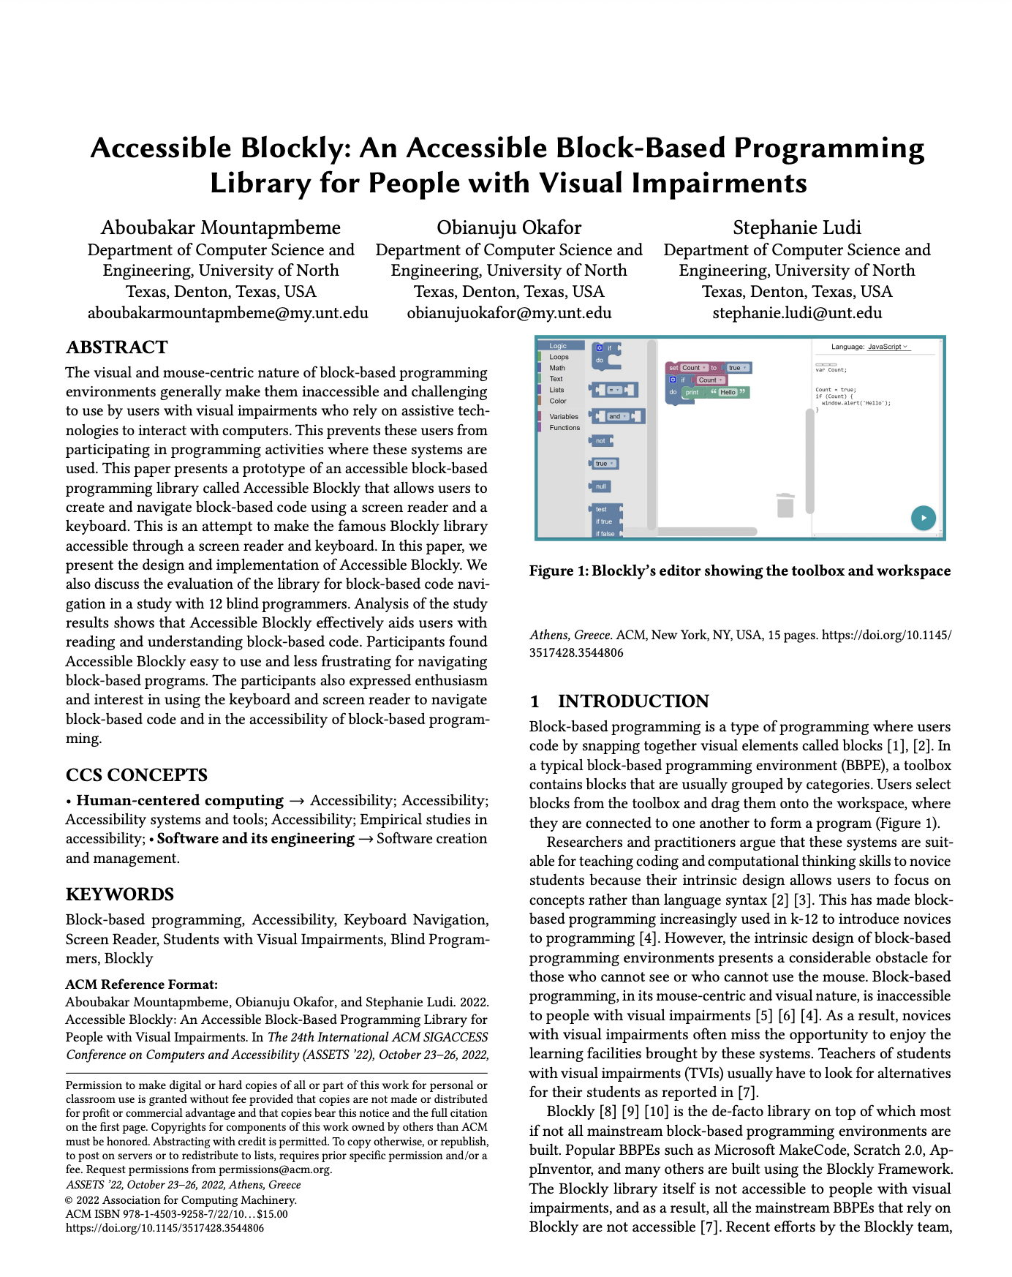
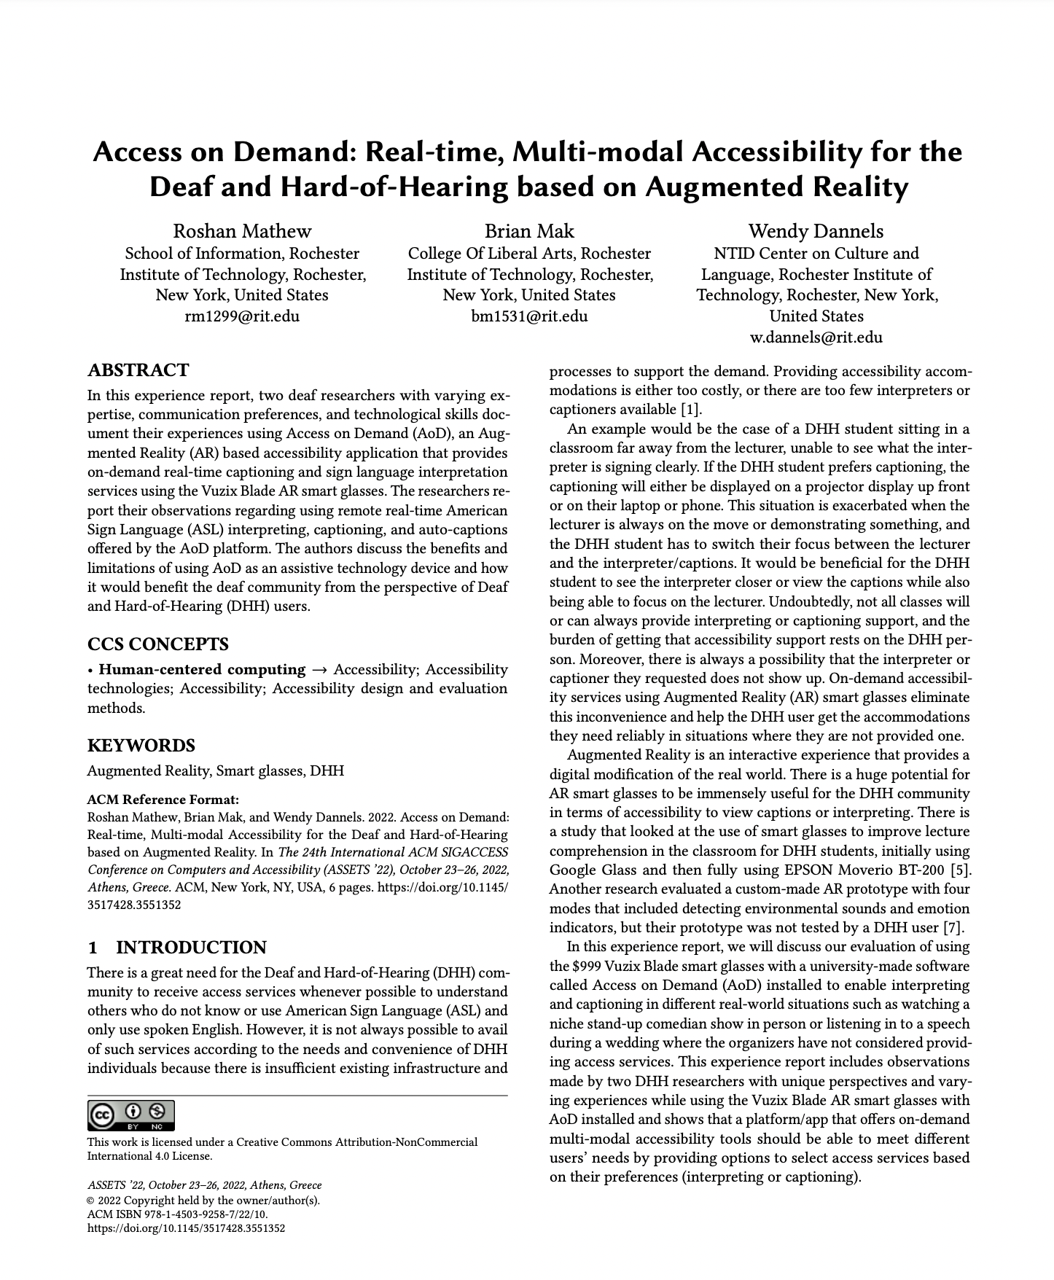
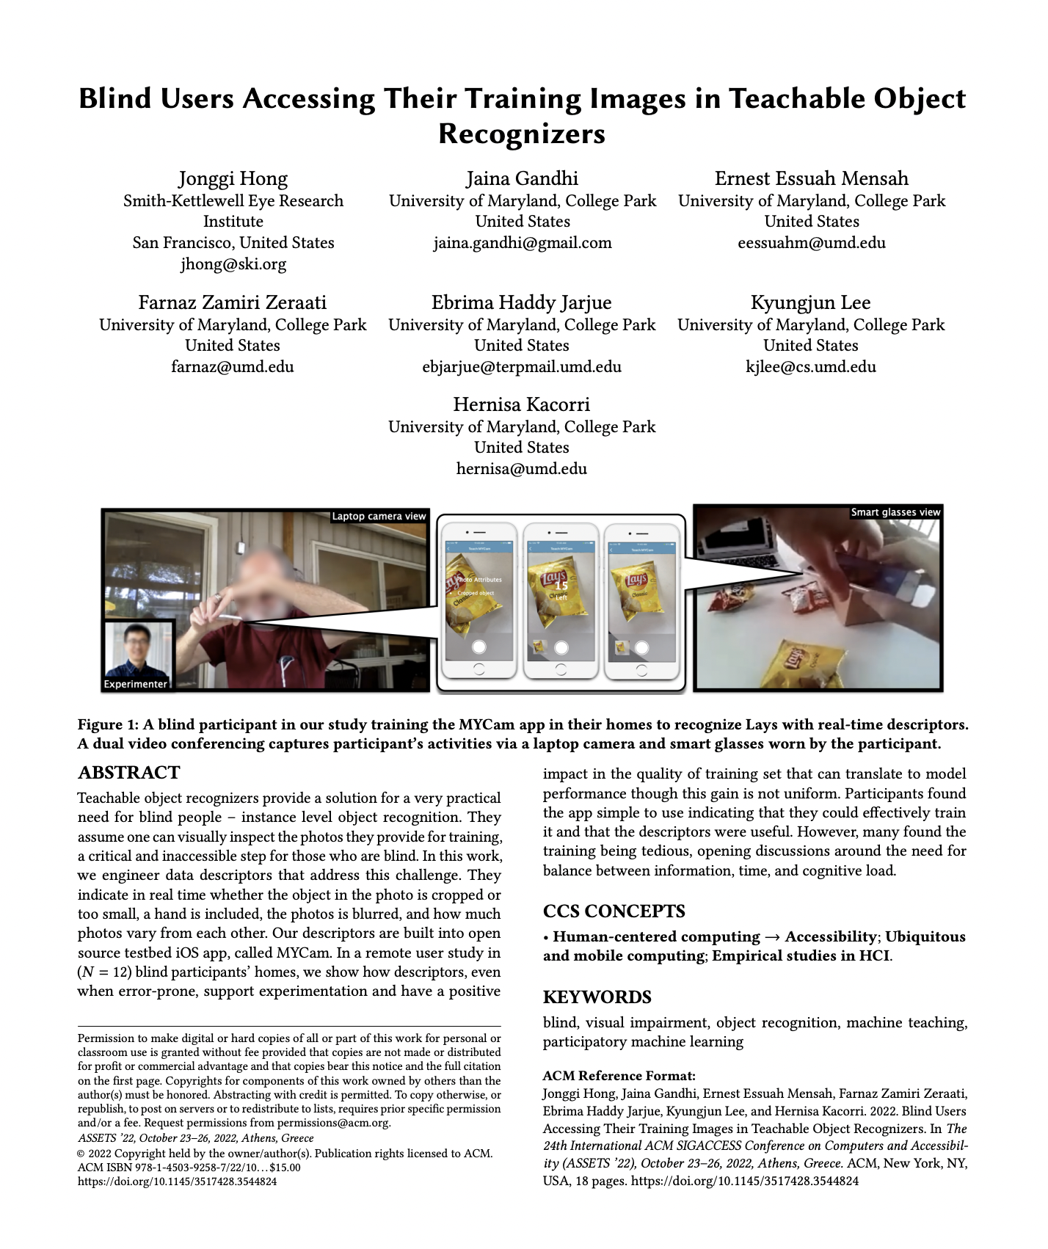
Full Papers
ASSETS’22
132 submissions
35 Acceptances
26.5% acceptance rate

Slide 30
Diverse content
ASSETS’22
Representation and Inclusion
AR, VR, and Games
Composition and Music
Tactile and Haptics
Social Media and Media
Safety and Transportation
Programming and Design
Accessibility in Daily Living
Data for Modeling and Recognition
Communication
Notes:
Across these papers, we have a wonderful variety of papers from AR, VR, and Games to Composition in Music, to Tactile and Haptics, and so many more

Slide 31
Other Tracks and program notes
ASSETS’22
7 Experience Reports
6 TACCESS Journal Paper Presentations
39 Posters and 4 Demos
17 Doctoral Consortium Participants
5 Workshops
Notes:
You’ll notice in the program we begin with experience reports and end with taccess papers where relevant, to set the tone and wrap each session.

Slide 32
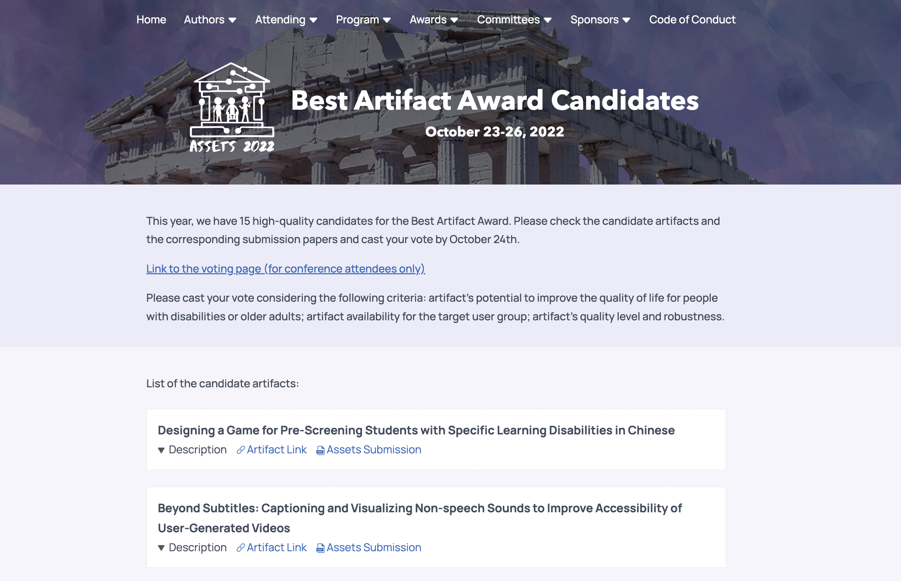
Best Artifact Award Candidates
Vote Here
Notes:
We’re happy to once again have a Best Artifact Award. Please vote for your choice of Best Artifact through the link on the conference web page
----
publicly available apps, data sets, commercial products, or open-source projects on the conference web page.
The Top-3 Best Artifacts will be selected based on the project’s contribution to the field of accessibility. A combination of delegate voting and input from a panel of judges will determine the winners.

Slide 33
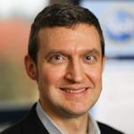
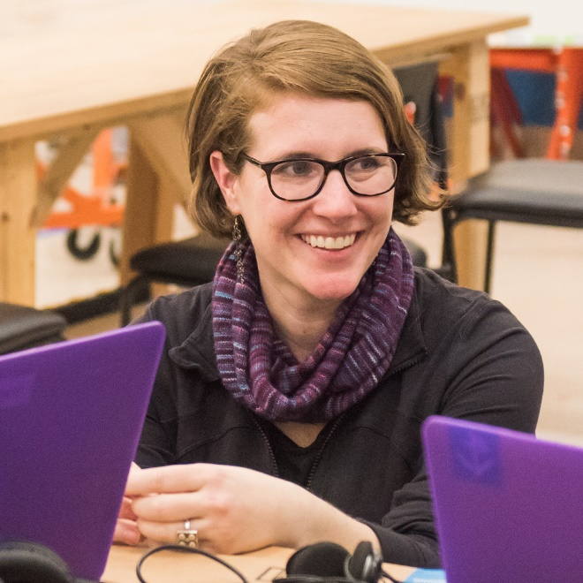
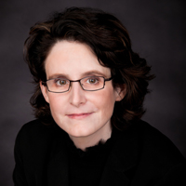


Best Paper Committee
ASSETS’22
Anthony Hornof U. of Oregon
Amy Hurst U. of Oregon
Cynthia Putnam DePaul
Sayan Sarcar Birmingham City U.
Gerhard Weber Technische U. Dresden
Notes:
This year’s best papers were selected by a best paper committee composed of five people and led by Professor Hornof at the University of Oregon

Slide 34
8 Best Paper Nominees: First Four
ASSETS’22
1
Quantifying Touch: New Metrics for Characterizing What Happens During a Touch Junhan Kong, Mingyuan Zhong, James Fogarty, Jacob Wobbrock, University of Washington
Accessible Blockly: An Accessible Block-Based Programming Library for People with Visual Impairments Aboubakar Mountapmbeme, Obiamuju Okafor, Stephanie Ludi, University of North Texas
LaMPost: Design and Evaluation of an AI-assisted Email Writing Prototype for Adults w/ Dyslexia Steven Goodman¹, Andy Coenen², Aaron Donsbach², Tiffanie Home², Michael Lahav², Robert MacDonal², Rain Breaw Michaels², Agit Narayanan², Mahima Pushkama², Rachel Sweeney², Meredith Ringel Morris² ¹University of Washington; ²Google
A Collaborative Approach to Support Medication Management in Older Adults with Mild Cognitive Impairment Using Conversational Assistants (CAs) Niharika Mathur¹, Tamara Zubatiy¹, Jiachen Li¹, Brian Jones¹, Elizabeth Mynatt² ¹Georgia Tech; ²Northeastern University
2
3
4
Notes:
The papers are…
(please hold your applause)

Slide 35
8 Best Paper Nominees: Next Four
ASSETS’22
5
Blind Users Accessing Their Training Images in Teachable Object Recognizers Jonggi Hong¹, Jaina Gandhi², Ernest Mensah², Famaz Zeraati², Ebrima Jarjue², Kyungiun Lee², Hernisa Kacorri² ¹Smith-Kettlewell Eye Research Institute; ²University of Maryland, College Park
AAC with Automated Vocabulary from Photographs: Insights from School and Speech-Language Therapy Settings Mauricio Fontana de Vargas, Jiamin Dai, Karyn Moffatt, McGill University
Chronically Under-Addressed: Considerations for HCI Accessibility Practice w/Chronically Ill People Kelly Mack, Emma McDonnell, Leah Findlater, Heather Evans, University of Washington
Support in the Moment: Benefits and use of video-span selection and search for sign-language video comprehension among ASL learners Saad Hassan, Akhter Al Amin, Caluã de Lacerda Pataca, Diego Navarro, Alexis Gordon, Sooyeon Lee, Matt Huenerfauth, Rochester Institute of Technology
6
7
8

Slide 36
Returning to In-person and virtual
161
141
In-person
Virtual
Synchronous
Asynchronous
Notes:
ASSETS’22 is our first attempt at having both an in-person and virtual experience

Slide 37
To bring us together
To bring us together
+
In-person
Virtual
Notes:
And, to help <click>

Slide 38
To bring us together
To bring us together
To bring us together
+
In-person
Virtual
Notes:
Bring us together

Slide 39




Discord intro
Web
Mac/Windows
Android/iPhone
Notes:
We will be using a text chatting platform called Discord, which is similar to Slack and runs in the web or natively on your phone or laptop

Slide 40

Discord link
https://assets22.sigaccess.org/
Notes:
You can find the Discord link on our website landing page

Slide 41
Discord link
https://assets22.sigaccess.org/
Notes:
Click on the “Join us on Discord”…

Slide 42

Example Discord Screenshot
Notes:
Discord might seem overwhelming at first but we’ve used it successfully for the past two virtual ASSETS
Similar to Slack, chat groups are organized into channels
---
I’m showing a screenshot of Discord. Let’s zoom in to the left panel

Slide 43

Example Discord Screenshot Zoomed In
All the content for Monday:
Opening plenary
Haben Girma’s keynote talk
Talk sessions
Posters
Demos
Virtual trivia
Notes:
For example, here’s the Monday channels. All of the sessions for Monday have channels including the Opening Plenary, the keynote, talk sessions

Slide 44
Example Discord Screenshot Zoomed In
Download pre-recorded talks, ask questions, chat with the community!
Selected first session
Notes:
If you select the first talk session for Monday—on AR, VR, and Games for accessibility—you’ll see all of the captioned videos for that content.
Here you can ask authors questions, discuss papers, and crossover between physical and virtual worlds

Slide 45
Captioned Videos on Discord
Every paper, poster, demo, etc. has a captioned video posted to discord

Slide 46

Fun/helpful Discord Channels
Fun/helpful channels like:
#athens
#help-desk
#selfie
#general
#introduce-yourself
And more!
Notes:
There are also a set of fun channels like #athens to share your Athens experiences, #help-desk to get help

Slide 47

Introduce Yourself Channel on Discord
Introduce yourself in the #introduce-yourself channel
Notes:
We encourage you to begin by introducing yourself on the #introduce-yourself channel

Slide 48

Selfie Channel on Discord
Selfies with old/new friends encouraged!
Post your selfies to the #selfie channel
Notes:
And post selfies to the selfie channel <clicl>
I'm showing an example selfie with ASSETS Registration Chair and Treasurer Martez Mott.
We encourage social selfies

Slide 49

Virtual Content
HDTVs Loop Videos with Captions
Notes:
For those that could not travel to Athens, we are playing pre-recorded captioned videos on loop in Olympia Hallway, including for posters, demos, experience reports, and doctoral consortium participants

Slide 50

ASSETS’22 Program at a Glance
Notes:
On our program webpage…

Slide 51
ASSETS’22 Program at a Glance (Zoomed In)
Crossover
Notes:
Look for areas marked as crossover events, which are simply encouragements to connect with virtual attendees on Discord and you can also setup your own meetings on Zoom out-of-band

Slide 52
ASSETS’22 Program with Virtual Events
Virtual only
Notes:
There are also two virtual only synchronous events happening in the middle of the night Athens time: virtual bingo and a virtual roundtable event
Both are aimed at helping virtual attendees network, have fun, etc.

Slide 53



Hybrid/Virtual Chairs
ASSETS’22
Christian Vogler
Gallaudet University
Emma McDonnell
UW
Laurianne Sitbon
Queensland U. of Tech
Kelly Mack
UW
Notes:
I want to thank the Hybrid/Virtual chairs for all their work on planning and organizing this feature of ASSETS

Slide 54
ASSETS’22 Crossover Activity Intro
ASSETS’22 Crossover activity
(5-10 minutes)
Notes:
To help you get a taste of using Discord and crossing over, we are going to do an activity

Slide 55
Discord
Web
Mac/Windows
Android/iPhone
Notes:
You are gonna need Discord for this….

Slide 56

ASSETS’22 Hybrid Bingo Card
B | I | N | G | O
Find someone who you share a common interest with you. What is their name & the common interest? [Your answer] | Find someone who prefers tea over coffee. What is their name and favorite kind of tea? [Your answer] | Find someone who is attending ASSETS (virtually or in Athens) for the first time. Who is it? [Your answer] | Find someone who works in industry, do they have any pets. Who and what pets? [Your answer] | Find someone who is a self-identified night owl. What is their name and what time do they go to bed? [Your answer]
Find a student who is not from your institution. What is their name and favorite snack food? [Your answer] | Find someone who is attending ASSETS in person for the first time. What is their name & affiliation? [Your answer] | Find a student volunteer. What is their name and favorite book? [Your answer] | Find someone you've never met who is attending ASSETS virtually on Discord. What is their name? [Your answer] | Find someone who likes to dance. What is their name and their favorite song to dance to? [Your answer]
Find a post doc, what is their favorite project that they've worked on? [Your answer] | Find someone who identifies as Gen Z. What is their name and ask if they have ever used a VCR? [Your answer] | Introduce yourself on the #introduce-yourself Discord channel | Find a professor who is not from your institution, what is their name and favorite book and why? [Your answer] | Find someone on Discord that works in a similar research area to you. Who did you talk to and what area? [Your answer]
Find someone who likes the same band/artist as you. Who did you talk to and what is the artist? [Your answer] | Find someone who speaks two languages. List their name and languages. [Your answer] | Find someone who uses sign language. What is their name and affiliation? [Your answer] | Find someone on Discord who has the same birth month as you. Who is it and what month? [Your answer] | Find someone who has been to 3 or more continents. What is their name & where they go? [Your answer]
Find someone who speaks Greek. What is their name? [Your answer] | Find someone who has attended ASSETS 6+ times: who is it and how many times have they attended ASSETS? [Your answer] | Find someone who has gone on a run or worked out today, what is their name and how far did they run? [Hint: ask Bigham] [Your answer] | Take a selfie with someone at the conference and post it to the #selfie Discord channel with your names. [Your answer] | Find someone who is attending ASSETS from a different timezone than you. What is their name and where are they attending ASSETS? [Your answer]
Notes:
ASSETS’22 introduces the first-ever Hybrid ASSETS Bingo, which is a bit like a social treasure hunt in Bingo form
----
https://docs.google.com/spreadsheets/d/1sWzz-Q_DEAS8J3V0bqF9egBBTpGncSKNbjr8a-1aVk4/edit#gid=0

Slide 57
B | I | N | G | O
Find someone who you share a common interest with you. What is their name & the common interest? [Your answer] | Find someone who prefers tea over coffee. What is their name and favorite kind of tea? [Your answer] | Find someone who is attending ASSETS (virtually or in Athens) for the first time. Who is it? [Your answer] | Find someone who works in industry, do they have any pets. Who and what pets? [Your answer] | Find someone who is a self-identified night owl. What is their name and what time do they go to bed? [Your answer]
Find a student who is not from your institution. What is their name and favorite snack food? [Your answer] | Find someone who is attending ASSETS in person for the first time. What is their name & affiliation? [Your answer] | Find a student volunteer. What is their name and favorite book? [Your answer] | Find someone you've never met who is attending ASSETS virtually on Discord. What is their name? [Your answer] | Find someone who likes to dance. What is their name and their favorite song to dance to? [Your answer]
Find a post doc, what is their favorite project that they've worked on? [Your answer] | Find someone who identifies as Gen Z. What is their name and ask if they have ever used a VCR? [Your answer] | Introduce yourself on the #introduce-yourself Discord channel | Find a professor who is not from your institution, what is their name and favorite book and why? [Your answer] | Find someone on Discord that works in a similar research area to you. Who did you talk to and what area? [Your answer]
Find someone who likes the same band/artist as you. Who did you talk to and what is the artist? [Your answer] | Find someone who speaks two languages. List their name and languages. [Your answer] | Find someone who uses sign language. What is their name and affiliation? [Your answer] | Find someone on Discord who has the same birth month as you. Who is it and what month? [Your answer] | Find someone who has been to 3 or more continents. What is their name & where’d they go? [Your answer]
Find someone who speaks Greek. What is their name? [Your answer] | Find someone who has attended ASSETS 6+ times: who is it and how many times have they attended ASSETS? [Your answer] | Find someone who has gone on a run or worked out today, what is their name and how far did they run? [Hint: ask Bigham] [Your answer] | Take a selfie with someone at the conference and post it to the #selfie Discord channel with your names. [Your answer] | Find someone who is attending ASSETS from a different timezone than you. What is their name and where are they attending ASSETS? [Your answer]
Notes:
For example, the center square—which is one of the few that can be done alone—is simply to introduce yourself on the introduce yourself channel
---
https://docs.google.com/spreadsheets/d/1sWzz-Q_DEAS8J3V0bqF9egBBTpGncSKNbjr8a-1aVk4/edit#gid=0

Slide 58

Screenshot of the Introduce Yourself Channel
Notes:
Here, I’m showing a screenshot of the #introduce-yourself channel… so a number of people have already done this--so you get to fill out the first square

Slide 59
Discord link
https://assets22.sigaccess.org/
Notes:
And remember, you can go to the ASSETS2022 webpage

Slide 60
Discord link
https://assets22.sigaccess.org/
Notes:
And look for the ”Join us on Discord link”

Slide 61
Try these one of these Three
ASSETS’22 Bingo
~10 min activity!
Introduce yourself on the #introduce-yourself Discord channel | Take a selfie with someone at the conference and post it to the #selfie Discord channel. Remember to add alt text. | Find someone who is attending ASSETS in person for the first time. What is their name & affiliation?

Slide 62

Jon’s Bingo Card Example
Notes:
Here’s my bingo card
---
Jon’s bingo card:
https://docs.google.com/spreadsheets/d/1SMCMnU1_m2fdzzXHOadOmQnBpr0f9lIRfKW78EirB5M/edit#gid=0

Slide 63

ASSETS’22 T-Shirt
Notes:
If you fill out a full row, column, or diagonal, submit your bingo card on the #bingo channel and enter to win an ASSETS’22 t-shirt designed by Liang He
--
Win an ASSETS’22 t-shirt designed by Liang He that has a stylized printed-circuit board Parthenon with a cane user, a wheelchair user, and a signer within it and a water color background in blue and purple

Slide 64
What does it take to plan and execute ASSETS’22?

Slide 65
PEOPLE!
Notes:
People.
I am incredibly grateful for the support of our community.
This conference is a representation of so much work together

Slide 66
49 Organizing Committee Members
49
15
Countries
Organizing Committee
Notes:
49 members of the organizing committee from 15 countries, many who went above and beyond planning both virtual and in-person components

Slide 67
73 Program Committee Members
73
Program Committee
Notes:
73 program committee members

Slide 68
50 Student Volunteers
50
Student Volunteers
10 in-person | 40 virtual
Notes:
50 student volunteers -- 10 in person and 40 virtual

Slide 69










SIGaccess Steering committee
Opening plenary
2022
Matt Huenerfauth SIGACESS Chair, RIT
Jeff Bigham
CMU
Tiago Guerreiro
U. de Lisboa
Jonathan Lazar UMD
Kathleen McCoy U. of Delaware
Karyn Moffatt McGill Univ.
Notes:
The SIGACCESS Steering Committee both in 2022 and 2021
We've been planning this ASSETS for 18 months

Slide 70



SIGaccess Steering committee
Opening plenary
2021
Shari Trewin
SIGACCESS Chair, Google
Jeff Bigham
CMU
Jinjuan Feng Towson Univ.
Tiago Guerreiro
U. de Lisboa
Faustina Hwang
U. of Reading
Jonathan Lazar UMD
2022
Matt Huenerfauth SIGACESS Chair, RIT
Jeff Bigham
CMU
Tiago Guerreiro
U. de Lisboa
Jonathan Lazar UMD
Kathleen McCoy U. of Delaware
Karyn Moffatt McGill Univ.

Slide 71

11,869 Slack Messages
11,869
messages
Notes:
---
https://assets22.slack.com/admin/stats

Slide 72

541 Github commits
541
Commits
ASSETS’22 Website
Notes:
---

Slide 73

2362 ASSETS’22 Emails
2,362
ASSETS’22 Emails
Since Dec 1, 2020

Slide 74

55,000 website views
55,000
Website Views
Since Feb 1, 2022

Slide 75
17 Sponsors
17
Sponsors
Notes:
And 17 sponsors, for which this conference would otherwise not happen

Slide 76

Champion sponsors
sponsors
Notes:
Let’s thank Fable

Slide 77

Champion sponsors
sponsors
Notes:
Google..

Slide 78






Gold sponsors
sponsors
Notes:
Adobe
Amazon
Apple
The University of Washington Center for Research and Education on Accessible Technology and Experiences
Meta
Microsoft

Slide 79

Discord Sponsor Channels

Slide 80

Zoomed-in View of the Discord Sponsor Channels
Chat with Champion/Gold sponsors on their Discord channels!

Slide 81



Silver sponsors
sponsors
Notes:
The National Institute on Disability, Independent Living, and Rehabilitation Research
Twitter
Volksgwagen

Slide 82




Bronze Level
sponsors

Slide 83


Other Sponsors
Sponsors
Doctoral Consortium
Free Service to ASSETS’22 Participants in Athens

Slide 84
Some concluding words

Slide 85

Code of conduct
ASSETS’22
Exercise consideration and respect in your speech and actions
Refrain from demeaning, discriminatory, or harassing behavior and speech
Be mindful of your surroundings and of your fellow participants
Alert assets22-leadership@acm.org if you notice a dangerous situation, someone in distress, or violations of this policy, even if they seem inconsequential.

Slide 86

COVID SAFETY
https://bit.ly/ASSETS22-COVID
Notes:
We have a detailed COVID safety plan on our website

Slide 87


Masks are required at all assets events
ASSETS’22
160 N95s Avail.
50 ClearMasks Avail.
Wear a high-filtration mask N95, KF94, FFP2, or KN95
Or a clear mask:
BendShape ClearMasks
Notes:
Masks are required at all ASSTS events <click>
We have 160 N95s available and 50 ClearMasks as backups
--
https://assets22.sigaccess.org/attending-athens.html#covid-safety
N95, KF94, FFP2, or KN95
Speakers may pull down their masks to speak

Slide 88

COVID Protocol
ASSETS’22
If you feel sick during the conference, email conferencestaff@acm.org, take a rapid antigen test, and stay in your hotel room.
We have 40 antigen tests
If you test positive within 10 days of ASSETS, report result to: conferencestaff@acm.org

Slide 89

Quiet room: Room 102
ASSETS’22
If you need space to yourself
There is a bathroom
You can get a key from an SV
Notes:
If you need space for yourself, we have a quiet room in Room 102 with a bathroom. You can get a key from an SV.

Slide 90
Let’s make this the best ASSETS ever
The 24th International ACM SIGACCESS Conference on Computers and Accessibility
Athens, Greece
Oct 23-26
Notes:
Together, let’s make this the best ASSETS ever

Slide 91

KEYNOTE SPEAKER: HABEN GIRMA
ASSETS’22
The first Deafblind person to graduate from Harvard Law School, Haben Girma is a human rights lawyer advancing disability justice.
President Obama named her a White House Champion of Change. She’s also received recognition from President Bill Clinton, Prime Minister Justin Trudeau, & Chancellor Angela Merkel.
She received the Helen Keller Achievement Award, a spot on the Forbes 30 Under 30 list, and TIME100 Talks
After her talk, Haben has asked questioners to join her on stage if they are comfortable. And she will be in the dining space across the hall for a meet-and-greet afterwards.
Notes:
It is now my pleasure to introduce our distinguished Opening Keynote speaker Haben Girma who is a worldwide leader in disability rights and believes disability is an opportunity for innovation.
Haben is the…
She has received countless recognition
Join me in recognizing

